Slide 1
PRINCIPLES IN SERVING THE LORD

Slide 3
I-The Desire and the Motive
The service of the Lord is not about positions but about taking the last place. It is similar, to the Lord‘s service when he washed the Disciples‘ feet.
It is because of these examples which come across many priests in their service, and because I know of many who have such thoughts, that I present to you some of the principles in the service, praying to the Lord that it becomes a source of blessing to many and to me also.

Slide 4
II-WHO IS THE TRUE SERVANT?
-First: Tasted the life with Christ and loved it.
-Second: His service is generated from his love to Christ, to his brethren, to his family and his heavenly reward.
-Third: His aim is to attract souls to Christ for their salvation without ignoring the daily life that these souls live.

Slide 5
First: The true servant is the person who tasted the life with Christ and loved it.
-He who lacks something cannot give it.
-If a person tried to speak about Christ without having experienced life with Him, he will sound theoretical and will not be fruitful. But if he experienced being in contact with Christ and tasted the beauty of living with Him and formed a practical knowledge, then the simplest words coming from his heart will have the power and effect to reach other hearts.
-Examples:

Slide 6
St. Peter the Apostle was able to convert 3000 souls in one sermon after completing his faith, receiving the power of the Holy Spirit and experiencing the true life with Jesus Christ (Acts2).
St. Paul the Apostle, after experiencing life with Christ, said “But indeed I also count all things loss for the excellence of the knowledge of Christ.”(Philippians 3:8)
Andrew the Apostle called upon his brother Simon Peter after his true experience of Christ. Andrew found his own brother Simon, and said to him, “We have found the Messiah” (which is translated, The Christ), and he brought him to Jesus.
Jesus found Philip and said to him, “Follow Me”. Philip called Nathanael also, and said to him, “we have found Him of whom Moses in the law, and also the prophets, wrote. Jesus of Nazareth, the Son of Joseph” And Nathanael said to him, “can anything good come out of Nazareth?” Philip said to him, “Come and see” (John 1: 40-46).
Therefore, the servant needs first to have a true relationship with Christ. Then he presents the soul that he wants to serve to Jesus.

Slide 7
Second: The true servant is he whose service generates from his love to Christ, his brethren, his family and his heavenly reward
Love to Christ: as St Paul said: “And though I bestow all my goods to feed the poor, and though I give my body to be burned, but have not love, I am nothing” I Corinthians 13:3.
Love to others:
a- The Lord said to Simon Peter “Simon...do you love Me? Tend My Sheep” John 1:15
b- Our lord Jesus Christ, who is our true example, demonstrated a service full of love and comparison “and for their sakes I sanctify Myself, that they also may be sanctified by the truth” John 17:19 Also, “But when He saw the multitude, He was moved with compassion for them, because they were weary…” Matthew 9:36
c- St. John said in affection, “The elder, to the elect lady and her children, whom I love in truth, and not only I, but also all those who have known the truth” 2 John :1.
d- As to the love of the poor, we find Abba Abra‘am Bishop of Fayoum
e- Abba Boutros the last martyrs who died in place of his congregation

Slide 8
Third: The true servant is he whose aim is to attract souls to Christ for their salvation without ignoring their daily life.
1- The aim of the service of the church is for the person to have life in Him (Christ), as David said ”You who seek God, Your heart shall live” Psalm 69:32
2- In the Prodigal Son parable, The father told the older son “ your brother was dead and is alive again; he was lost and is found” Luke 15:32.
3- Serving the children is different from serving the Youth. Serving the elderly is different from serving the sick and needy. The servant‘s aim is to attract the soul to heaven without overlooking its position and its daily life.
4- St. John the Baptist diverted the people and drew them towards Christ not himself. He said, “He must increase but I must decrease” John 3:30. A true example of faithful servant is in drawing the souls towards Christ. The ego should disappear in the ministry of Our Lord Jesus Christ.

Slide 9
III- THE SERVANT‘S WEAPONs are THE POWER FROM THE Lord AND his PRAYERs FOR THOSE HE SERVES.
1- After Christ ascension the disciples, St Mary and the women, all continued with one accord in prayer and supplication until coming of the Holy Spirit. Since that time, the ministry of the Apostles was fortified with the power of the Holy Spirit. Act 1 and 2:1
2- “And they continued steadfastly in the apostles’ doctrine and fellowship, in the breaking of bread, and in prayers” Act 2:42
3- The service of the first church was very strong because it was fortified with the power of the Holy Spirit and the prayers of the Apostles. The church was so strong that it is said in the book of Acts: “The Lord added to the Church daily those who were being saved” Acts 2:47
4- “Then the churches throughout all Judea, Galilee, and Samaria had peace and were edified. And walking in the fear of the Lord and in the comfort of the Holy Spirit, they were multiplied.” Acts 9:31

Slide 10
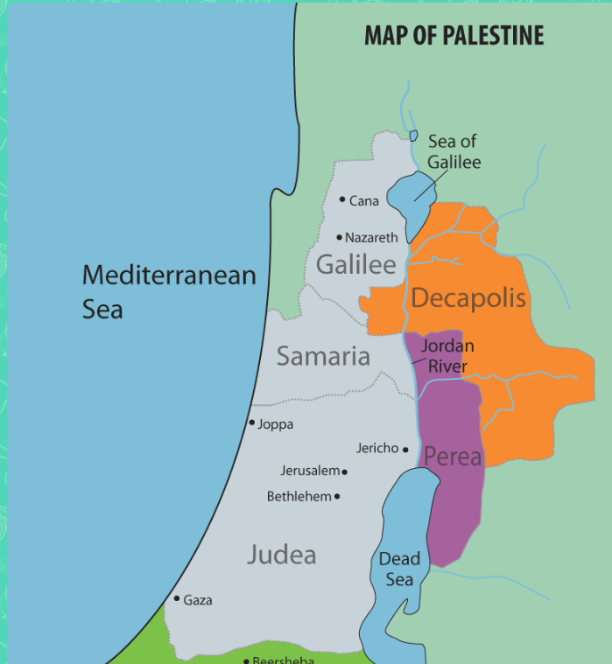
IV- THE PRIORITIES IN THE MINISTRY
The Last words of Jesus Christ to his disciples were:
But you shall receive power when the Holy Spirit has come upon you; and you shall be witnesses to Me in Jerusalem, and in all Judea and Samaria, and to the end of the earth.” Acts 1:8

Slide 11
1- Jerusalem: Being the city of the Great King that has the altar, it suggests that the heart and the spiritual life of the person, is the altar of the Lord. It means that I should take care of my spiritual life and my eternity first. So, the person continues his service with constant repentance, confession and receiving of the Holy Communion for the salvation of his soul.
2- Judea: The Jews are the nation to whom Christ came, but they rejected him. The testimony in Judea is the ministry of the servant in his own house, with his family and the small community he lives in. “But if anyone does not provide for his own, and especially for those of his household, he has denied the faith and is worse than an unbeliever” Timothy 5:8.
3- Samaria: Samaria was a mixture of Jews and atheists. The testimony in Samaria represents the ministry of the servant amidst the diligent believers and the weaker souls
4- The end of the earth: It is preaching among the other religions and those who have no religion. ”How beautiful are the feet of those who preach the gospel of peace, who bring glad tidings of good things” Romans 1

Slide 12
Specific steps in preparing the Youth for the Service:
1) The youth must experience the relationship with Christ in their personal life through their continual confession, repentance, receiving of the Holy Communion, spiritual readings, and attending church regularly.
2) The youth must start their service by simple jobs and not to hasten to taking teaching or controlling positions in the church. A youth may serve in the social activities, the library, taking care of the church building etc.. If he was blessed by being a deacon, he should enjoy the beauty of the hymns and the service in self-denial.
3) A youth should always be careful of his salvation and should behave properly among his family and friends at school or work.
4) Then the youth will evolve in love, disregarding the ego and love of self, and start serving the sick and the disabled and needy.
5) A youth will gradually start, according to the Lord‘s gift for him, teaching a small class of Sunday school. Then to a larger class if God permits and lastly, the youth service or any other services.

Slide 13
Questions?

