Slide 1
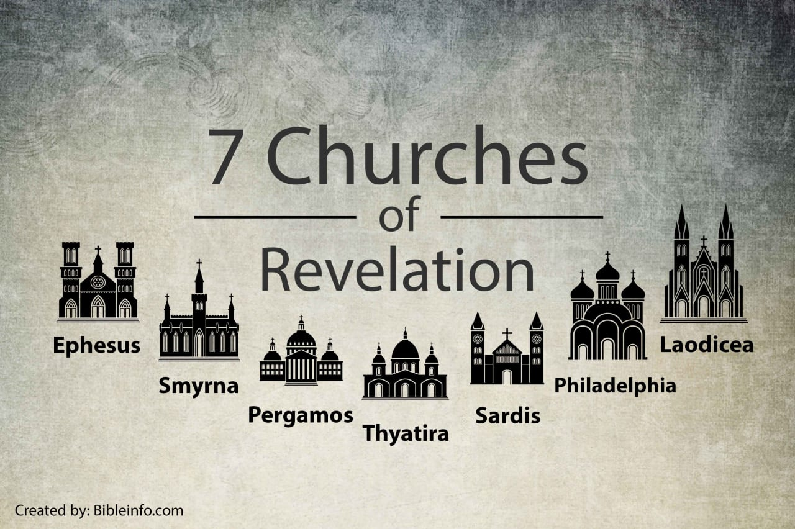
The Perfect Servant

Slide 2
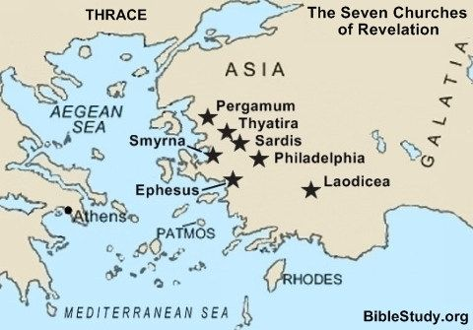

Slide 3
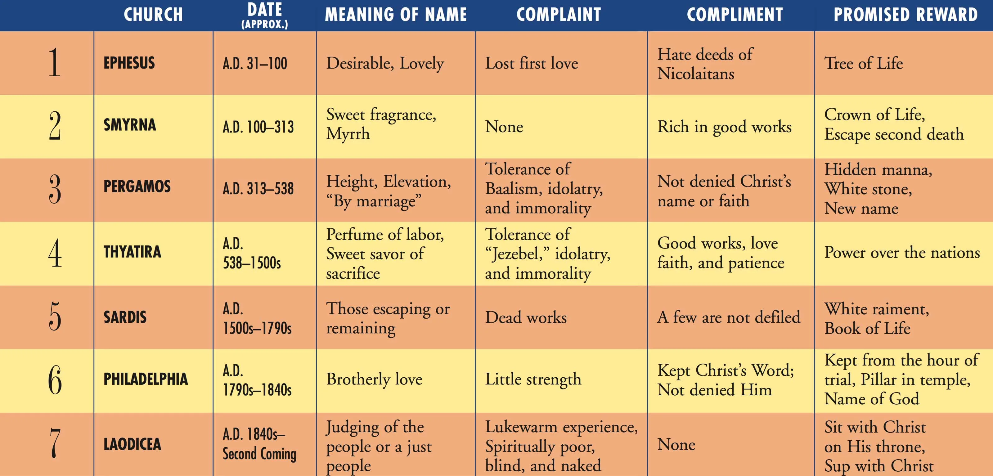

Slide 4
Church name | Complaint
Ephesus | I have this against you, that you have left your first love. (2:4)
Smyrna | Do not fear any of those things which you are about to suffer. (2:10)
Pergamos | But I have a few things against you, because you have there those who hold the doctrine of Balaam, who taught Balak to put a stumbling block before the children of Israel, to eat things sacrificed to idols, and to commit sexual immorality (2:14)
Thyatira | I have a few things against you, because you allow that woman Jezebel, who calls herself a prophetess, to teach and seduce My servants to commit sexual immorality and eat things sacrificed to idols. (2:20)
Sardis | Be watchful, and strengthen the things which remain (3:2)
Philadelphia | kept My word, and have not denied My name (3:8)
Laodiceans | you are neither cold nor hot. I could wish you were cold or hot (3:15)

