Slide 1
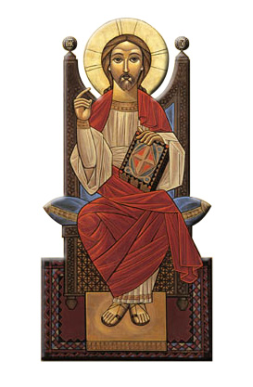
Spirituality of Liturgical Rites
Session 1
INTRODUCTION

Slide 2
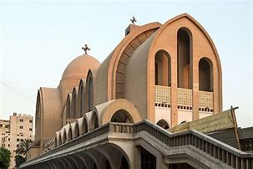
Liturgy (Public Worship) Greek: λειτουργία
PRIEST
DEACONS
CONGREGATION
Eucharist (Divine Liturgy)
Greek: εὐχαριστία

Slide 3
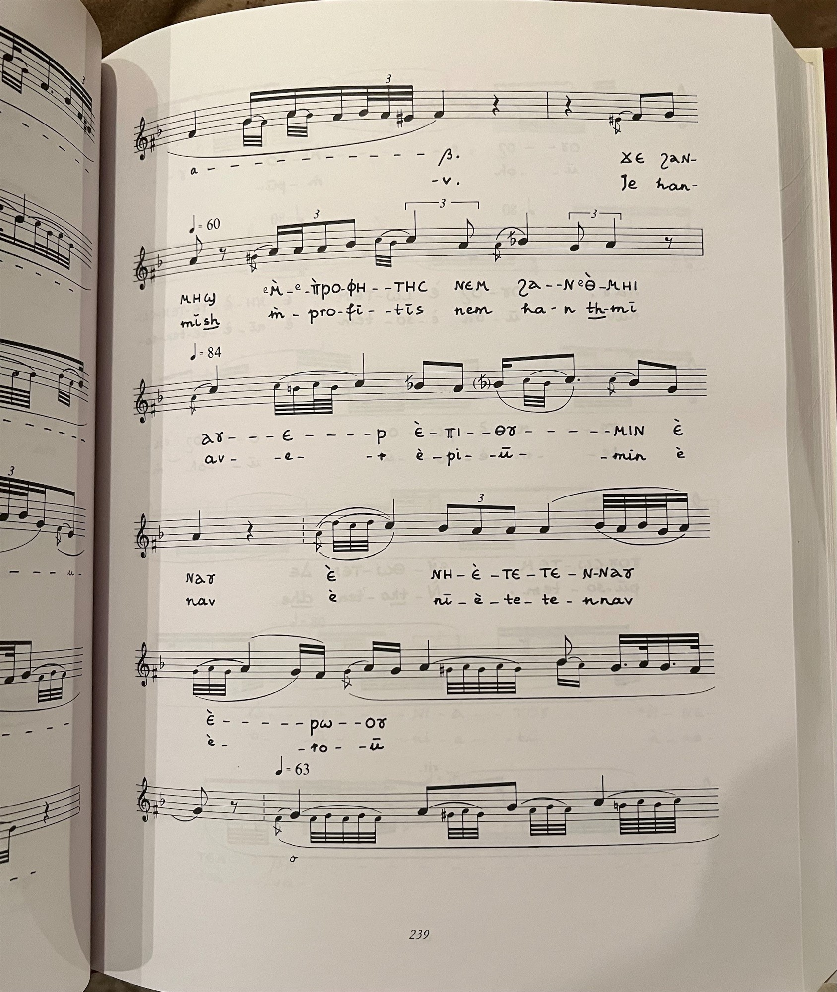
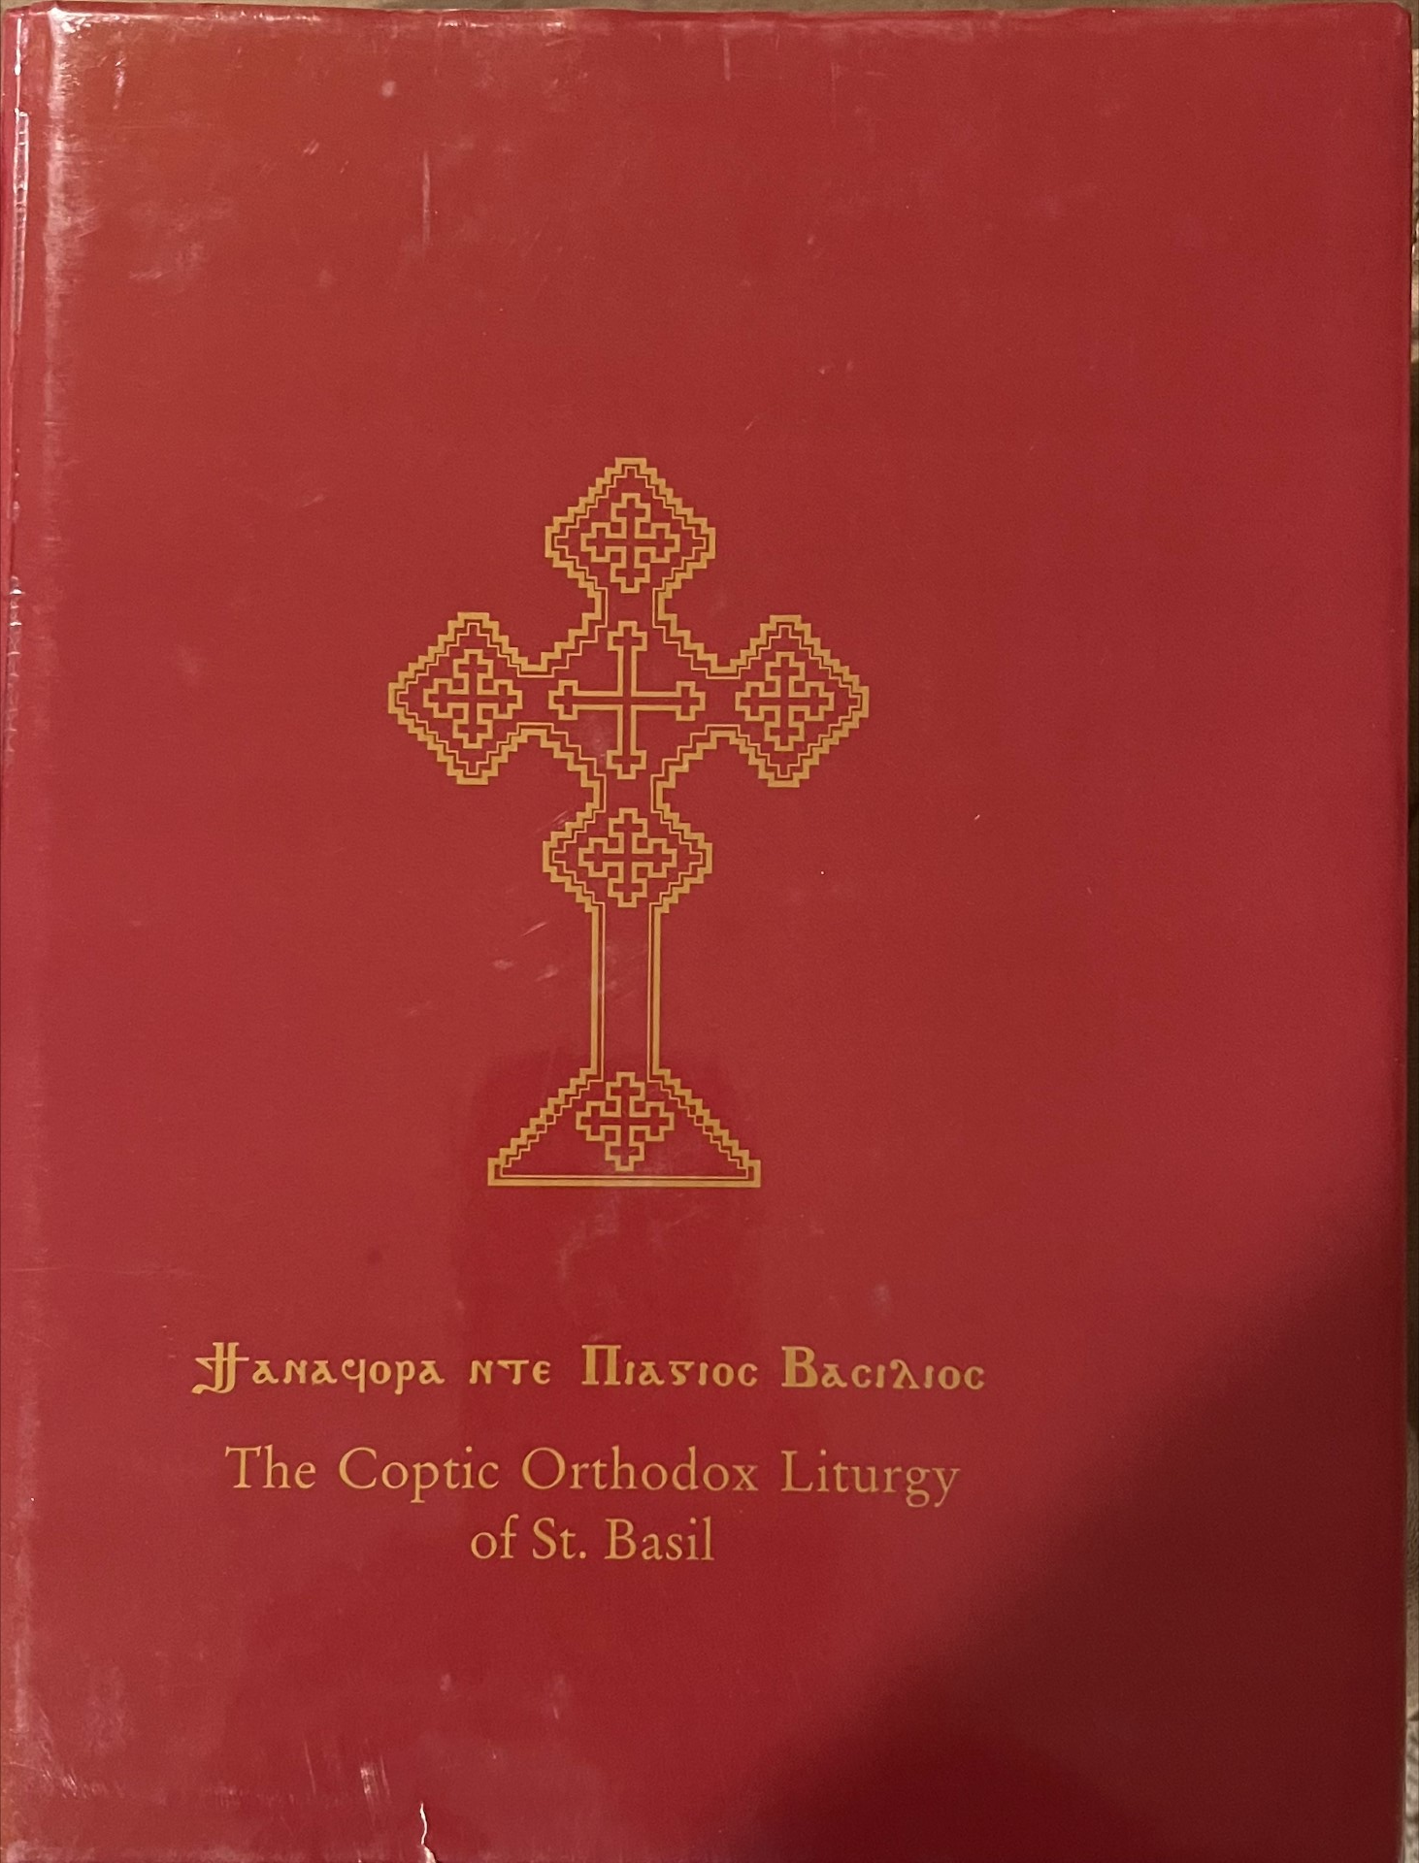
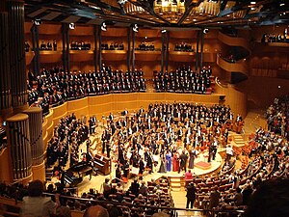
Symphony
Greek word συμφωνία (symphōnía), means "agreement or concord of sound“
(Harmony)

Slide 4
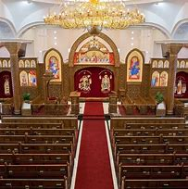
Precautionary Measures
(1) Not coming early to church “Those who seek Me early will find Me” (Proverbs 8:17).
(2) Not participating in the congregation responses “May Your servants, the ministers of this day, hegumens, priests, deacons, clergy, all Your people and my weak self be absolved...”.

Slide 5
Precautionary Measures
(3) Losing focus during the liturgy “I will pray with the spirit and I will also pray with understanding, I will sing with the spirit and I will also sing with understanding” (1 Corinthians 14:15).
(4) Being preoccupied with irrelevant matters “Those who lead, with diligence… fervent in spirit, serving the Lord, continuing steadfastly in prayer” (Romans 12:8-12).

Slide 6
In the House of God
As we enter the church
“But as for me, I will come into Your house in the multitude of Your mercy; In fear of You I will worship toward Your holy temple.” (Psalm 5:7).
Deacons recite psalms: 29 (I will exalt You, O Lord) 92 (The Lord has reigned)
Stand in awe and reverence
Learn the chants and follow the lead deacon

