Slide 1
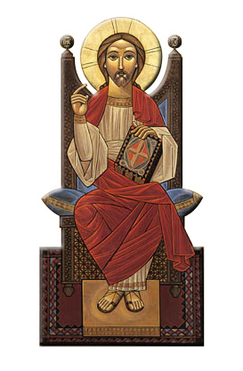
Spirituality of Liturgical Rites
Session 3
Offertory and Liturgy of the Word

Slide 2
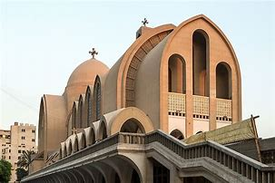
FOUR main Sections:
Raising of the incense
The Offertory
Liturgy of the Word
The Anaphora

Slide 3
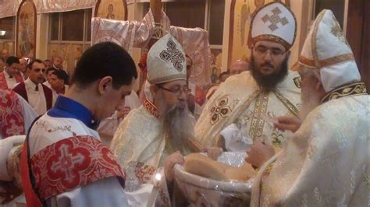
2. The Offertory
Selection of the lamb
“And He took bread, gave thanks and broke it, and gave it to them, saying, “This is My body which is given for you; do this in remembrance of Me.”
Luke 22:19

Slide 4
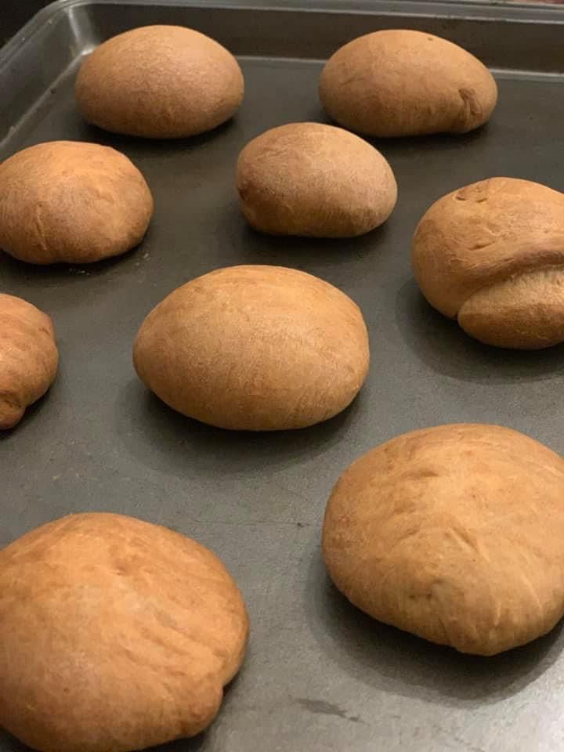
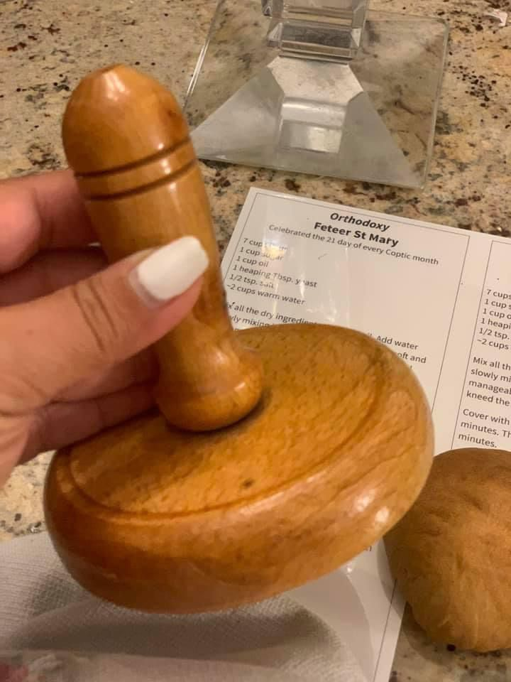
2. The Offertory
Selection of the lamb

Slide 5
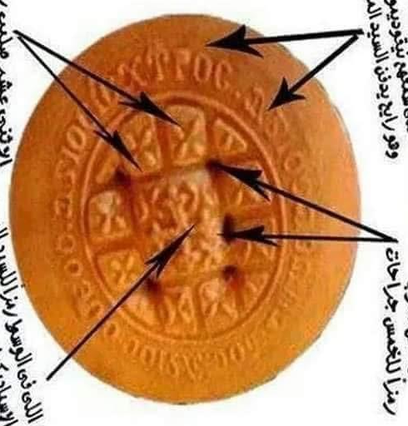
3 Agioc o :eoc
ic,uroc
a;anatoc
12
small crosses
5 holes
Middle Cross “Spadikon”

Slide 6
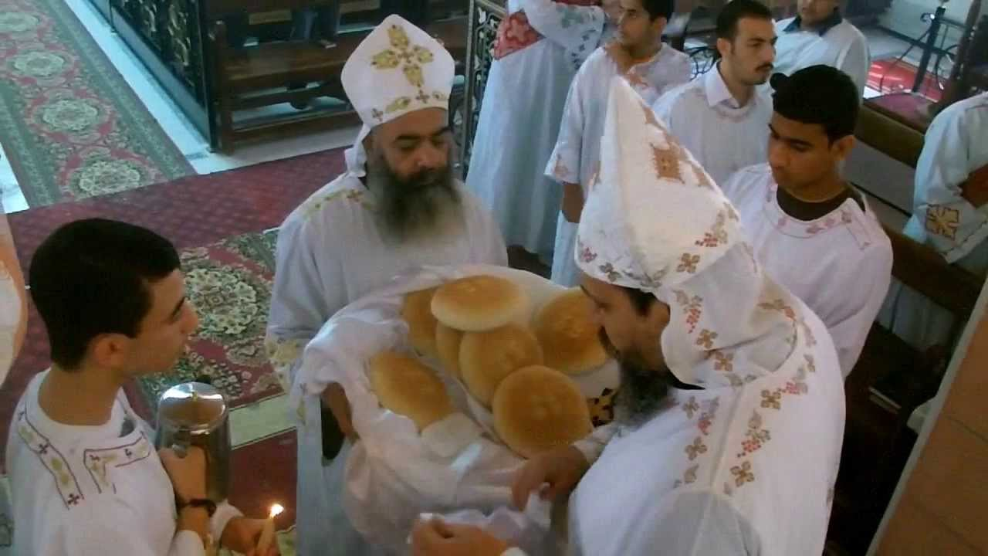
2. The Offertory
Selection of the lamb
“he took Him up in his arms and blessed God and said:
‘Lord, now You are letting Your servant depart in peace,
According to Your word;
For my eyes have seen Your salvation
Which You have prepared before the face of all peoples’”
Luke 2:28-31

Slide 7
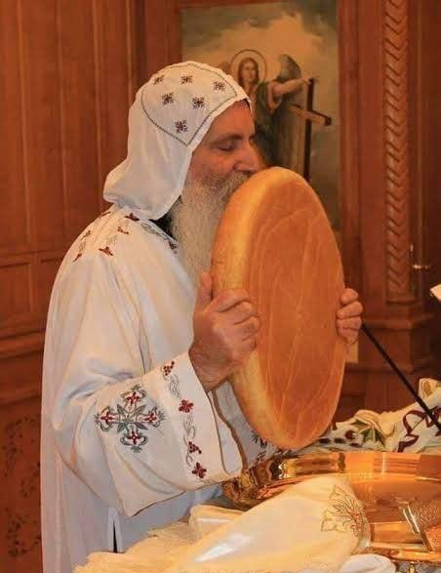
2. The Offertory
Selection of the lamb

Slide 8
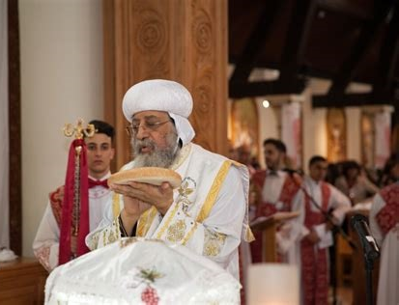
2. The Offertory
Selection of the lamb
“His left hand is under my head, and His right hand
embraces me”
Song of Songs 2:6

Slide 9
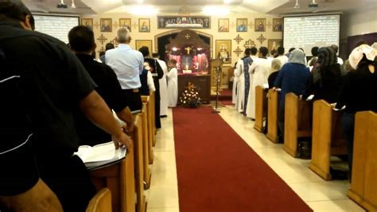
3. Liturgy of the Word (Catechumen)
(1) Pauline Epistle
(2) Catholic Epistle
(3) Acts of the Apostles
(4) Synaxarion (summary of the life of a saint)
(5) Psalm
(6) Gospel
(7) Sermon

Slide 10
3. Liturgy of the Word (Catechumen)
(1) Pauline Epistle (Paul = 14)
(2) Catholic Epistle (John = 3, Peter = 2, James = 1, Jude = 1)
(3) Acts of the Apostles (Luke)
(4) Synaxarion (summary of the life of a saint)
(5) Psalm
(6) Gospel (Matthew, Mark, Luke, John)
(7) Sermon

