Slide 1
The Real World

Slide 2

MTV 1990s

Slide 3
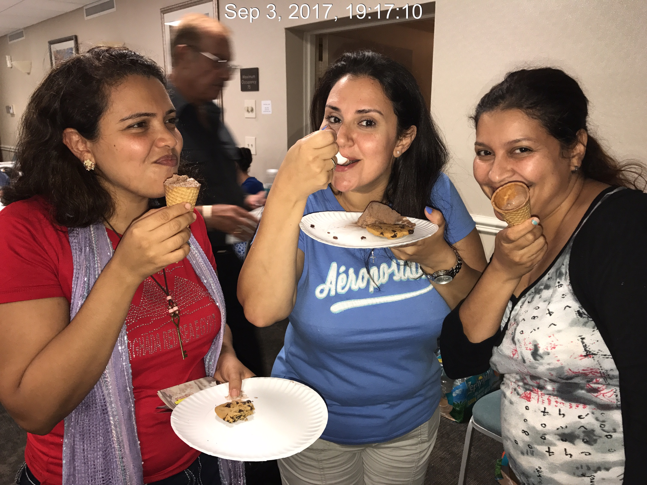
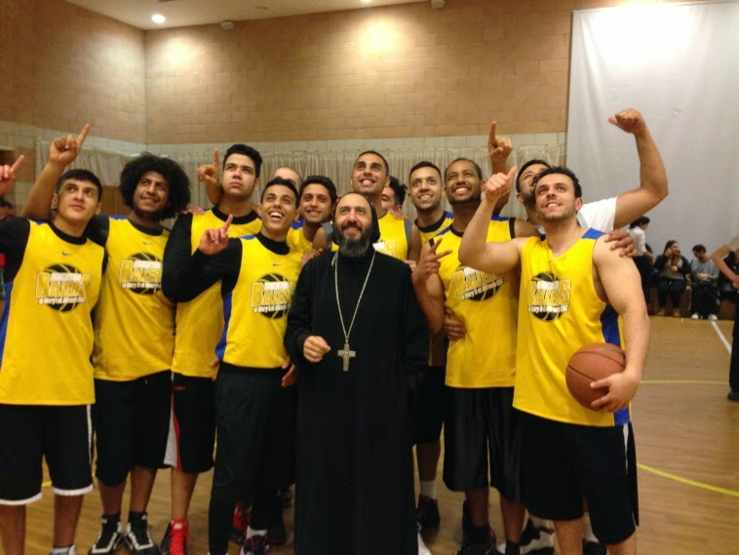
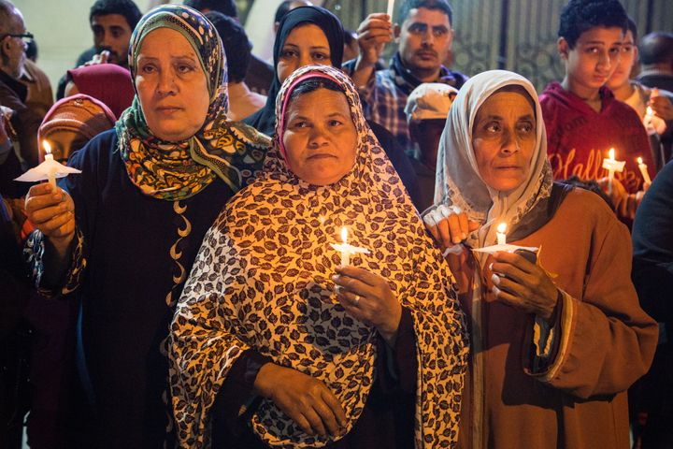
Diversity

Slide 4
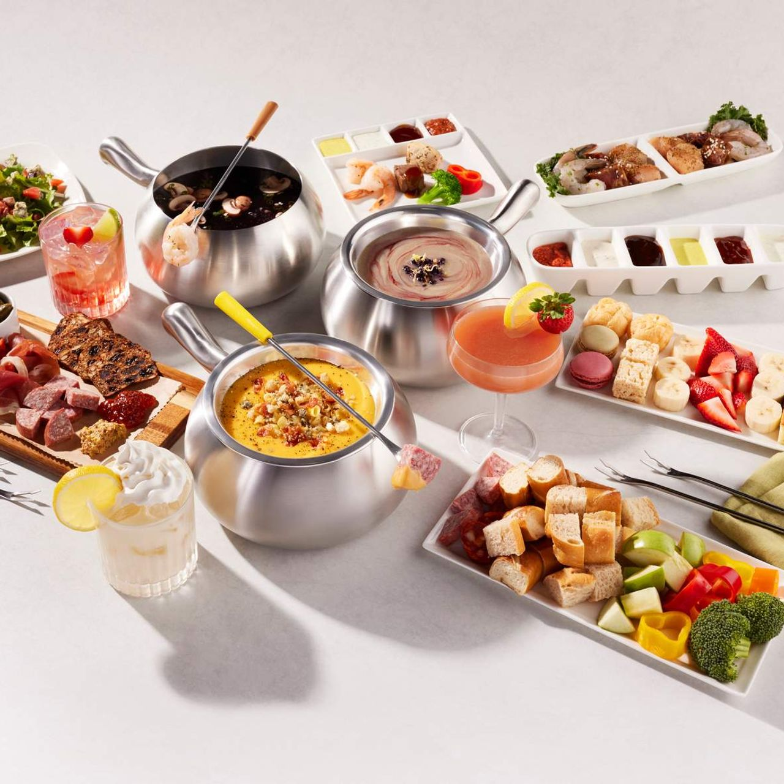
Many Different Backgrounds
The Church is a true melting pot:
Generations
Cultures
Socioeconomic backgrounds
Students
Young professionals
Families
Language
Expectations

Slide 5


What is the outcome of our diversity?
Stronger?
More disagreements?

Slide 6
Challenges
Tendency for older generations to expect to persuade others to follow their path
Innovation and energy can lead younger individuals to disregard experience
Lack of a dialogue that emphasizes the common goals

Slide 7
Human Nature
Barnabas and Paul disagreed in Acts 15
³⁵ But Paul and Barnabas remained in Antioch, where they and many others taught and preached the word of the Lord.
³⁶ Some time later Paul said to Barnabas, “Let us go back and visit the believers in all the towns where we preached the word of the Lord and see how they are doing.” ³⁷ Barnabas wanted to take John, also called Mark, with them, ³⁸ but Paul did not think it wise to take him, because he had deserted them in Pamphylia and had not continued with them in the work. ³⁹ They had such a sharp disagreement that they parted company. Barnabas took Mark and sailed for Cyprus, ⁴⁰ but Paul chose Silas and left

Slide 8
Human Nature
^{Luke 9}
^{The disciples’ disagreement}
⁴⁶ Then a dispute arose among them as to which of them would be greatest. ⁴⁷ And Jesus, perceiving the thought of their heart, took a little child and set him by Him, ⁴⁸ and said to them, “Whoever receives this little child in My name receives Me; and whoever receives Me receives Him who sent Me. For he who is least among you all will be great.”

Slide 9
How can we harness the benefits of diversity?
Mutual Love-We are all part of the body of Christ
Mutual Trust- Trusting that everyone has a common goal
Mutual respect-respecting other peoples input and differences
Foster the spirit of dialogue- Listen to others
Compromise- 50/50 rule

Slide 10
Questions?

Slide 12
Anxiety

Slide 13
Prevalence of anxiety
19% of US Adults experienced anxiety disorder in the past year
31% of adults experiences anxiety disorder in their lifetime
Anxiety is higher in females (23%) than males ( 14%)
32% of adolescents had an anxiety disorder

Slide 14
WHY IS ANXIETY RATE RISING?
HIGHER EXPECTATIONS
PRESSURES TO SUCCEED
SOCIAL MEDIA
Being constantly connected
Feeling that the world is a scary place

Slide 15
Anxiety in Sunday school kids
Challenges related to fitting in at school
Challenges related to reconciling Egyptian and American Cultures
Challenges arising from family dynamics

Slide 16
Features of anxiety
Irritability
Avoiding activities at school or church
Dropping grades
Trouble sleeping
Chronic physical complaints e.g. fatigue, headaches or stomach aches

Slide 17
How to handle anxiety
Try to build a community for the kids
Try to get to know the kids
Find activities that they like
Engage other senior servants that may connect the kids with professionals that can help
Using the scripture to shift kids focus away from the world that promotes anxiety
What scriptures?

