Slide 1

Self Esteem

Slide 2
Statistics
75% of girls with low self-esteem reported engaging in negative activities such as disordered eating, cutting, bullying, smoking, or drinking
70% of girls between ages 15 and 17 have avoided an activity because of low self-esteem
Two-thirds of adults feel that they did not have a significant figure in their lives who believed in them, contributing to low self-esteem

Slide 3
Statistics
1/3-1/2 of adolescents struggle with low self-esteem
50% of individuals in the UK feel like they are not part of a community, with no sense of belonging
37% of adolescents in the UK felt upset and ashamed of their body image

Slide 4
Statistics
People with low self-esteem are four times more likely to suffer from depression
People with high self-esteem have a significantly lower risk of anxiety and stress, and are 25% less likely to experience depression

Slide 5
What is low self esteem?
There is something wrong with me.
I do not belong here.
I do not like myself.
I do not have what it takes.
I do not compare well.
I want to hide.

Slide 6
Signs of low self esteem
Lack of confidence
External locus of control
Negative social comparisons
Trouble asking for help
Worry and doubt
Difficulty accepting compliments
Negative self-talk
Fear of failure
Poor outlook of the future
Lack of boundaries
Being a people-pleaser

Slide 7
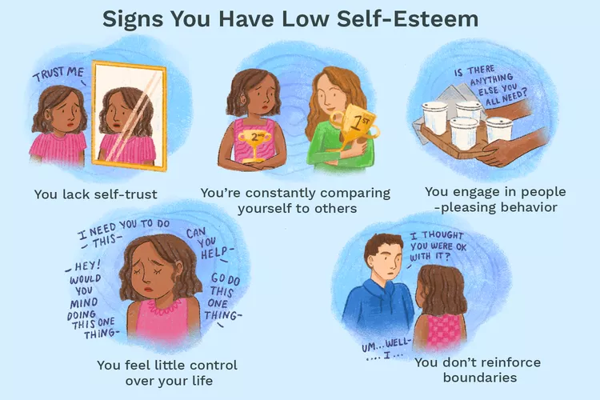

Slide 8
Potential Consequences of low self esteem
Anxiety
Eating disorders
Panic disorder
Risky behavior
Social anxiety
Substance use

Slide 9
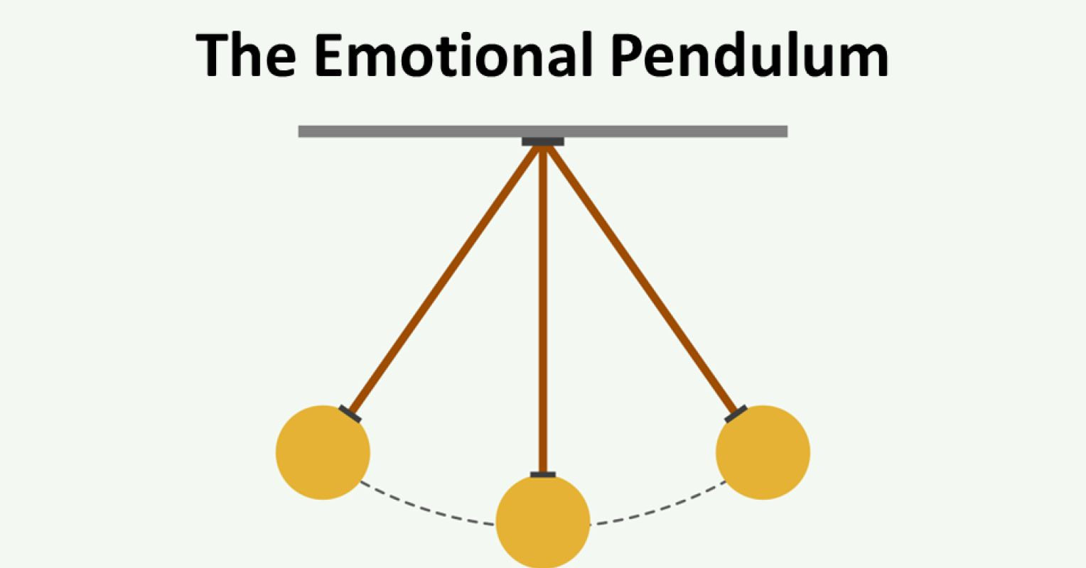
Low self esteem
Pride
Healthy self esteem

Slide 10
Pride
Pride is being SELF-ish
Pride’s base is too much SELF-love, SELF-worship
Thinking the worth of our SELF is higher than it actually is
Preoccupation with our image or SELF
Pride is SELF-centered or EGO-centric (everything revolves around us)
Pride wants to keep the focus on SELF

Slide 11
Pride
I can be anything I want to be.
I deserve more.
I do not need anyone else

Slide 12
Features of pride
Rarely ask questions of others because they’re more interested in their SELF than in the SELF of others
Dominate conversations talking about their SELF thinking or how much they know SO THAT we're impressed with their SELF
Rarely compliment people
Wait to be served instead of serve
Neglect others

Slide 13
Low self esteem
Pride
Healthy self esteem

Slide 14
Healthy self esteem
It means self-respect, self-acceptance, determination to go further in life, self-confidence

Slide 15
Healthy self esteem
My life has a purpose.
I can be anything God enables me to be.
I will seek forgiveness for my wrongs.
I belong here.
I can love and be loved.
I need others as they need me

Slide 16
Cure of Pride and low self esteem
For I say through the grace given to me, to everyone who is among you, not to think of himself more highly than he ought to think, but to think soberly, as God has dealt to each one a measure of faith‖ Rom.12:3

Slide 17
Self esteem in Sunday School
Self reflect on your attitude
  Is low self esteem keeping me from serving God and the congregation?
  Is low self esteem impacting my relationships

Slide 18
Pride in Sunday School
  Is pride impacting my relationships and service
    Do I accept feedback
    Do I judge others
    Do I listen to others
    Do I serve others to Glorify God or myself

Slide 19
Self esteem challenges in Sunday School
Empowering the children
Building a safe community for the children
Teaching them new skills
Empower them to excel academically or in sports
Create an environment that allows them to be comfortable

Slide 20
Questions?

