Slide 1

Anxiety

Slide 2
Outline
Anxiety stats
Potential causes of anxiety
Identifying anxiety
Managing anxiety

Slide 3
Anxiety stats
21% of adolescents aged 12-17 experienced anxiety symptoms
Higher for females (38.0%) than for males (26.1%).

Slide 4
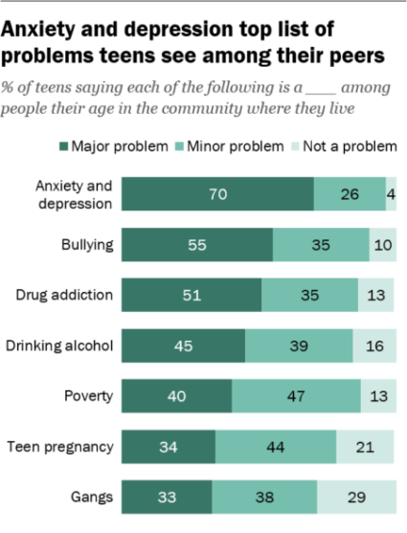
Anxiety stats

Slide 5
Anxiety is increasing in prevalence
Ever having been diagnosed with either anxiety or depression” among children aged 6–17 years increased from:
5.4% in 2003
8% in 2007
8.4% in 2011–2012

Slide 6
Anxiety in adults
31% of US adults have anxiety disorder in their life time
22.8% had serious impairment
33.7% had moderate impairment.¹
mild impairment (43.5%)

Slide 7
Why Anxiety?
In the Pew survey of teens, academic pressure tops their list of stressors:
61 percent say they face a lot of pressure to get good grades.
29 percent say they feel pressure to look good;
28 percent to fit in socially;
6 percent to drink alcohol.

Slide 8
Social media and anxiety
Eighth and 10th grade stu­dents spend an aver­age of 3.5 hours per day
U.S. adolescents aged 12–15 (n=6,595) that adjusted for baseline mental health status found that adolescents who spent more than 3 hours per day on social media faced double the risk of of depression and anxiety.

Slide 9
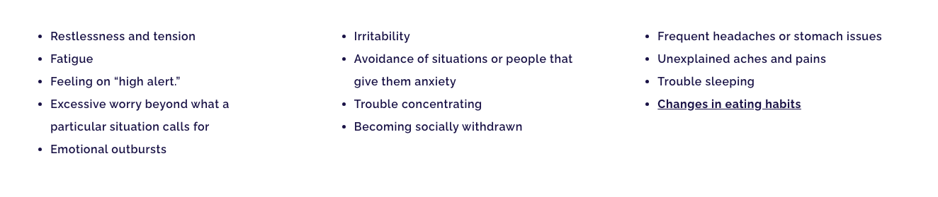
Symptoms of an anxiety disorder

Slide 10
Identifying Anxiety
Of children with anxiety:
more than 1 in 3 also had behavior problems (37.9%) and about 1 in 3 also had depression (32.3%).³
For children with behavior problems, more than 1 in 3 also had anxiety (36.6%) and about 1 in 5 also had depression (20.3%).³

Slide 11
Identifying anxiety
17% had symptoms of depression

Slide 12
How to manage axiety

Slide 13
Focus on god
―Be anxious for nothing, but in everything by prayer and supplication, with thanksgiving, let your request be made known to God; and the peace of God which surpasses all understanding, will guard your hearts and minds through Christ Jesus‖ Phil. 4:6-7

Slide 14
Living the life of thanksgiving
1 THESSALONIANS 5:16-18
Rejoice always, pray continually, give thanks in all circumstances; for this is God's will for you in Christ Jesus.

Slide 15
How to manage social media as a servant
Tech-free zone
Model responsible social media behavior
Discuss expectations of healthy use of social media
Discuss with parents parental controls

Slide 16
Resources for kids with anxiety
Consult elders/Clergy of the church
Counselors at school
Anxiety needs to get occasionally treated with medications

Slide 17
Thank you
Questions or comments

