Slide 1
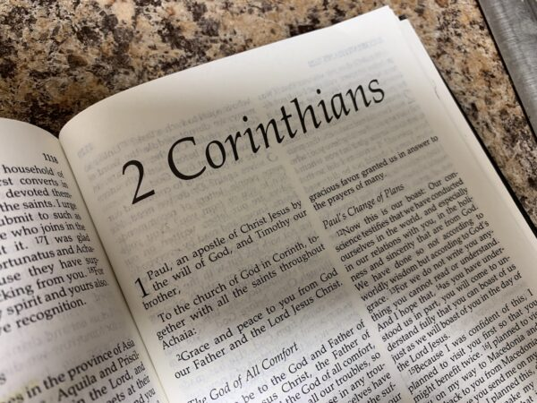
Servants Characters in second Corinthians Epistle

Slide 2
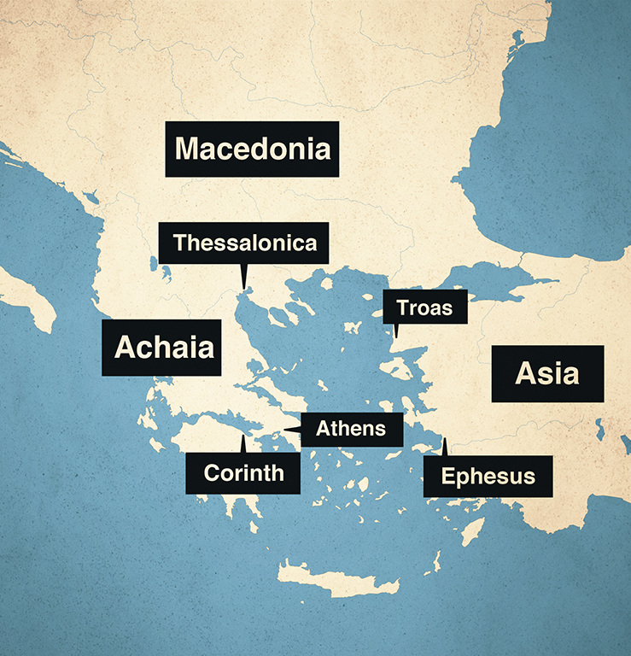
City of Corinth
Corinth was the 2nd most important city in the Roman empire. Corinth was an exceptionally wealthy and important city in Greece.
Corinth was the capital of Achaia and located 40 miles west of Athens
At one time the city was home to at least 12 pagan temples.
The Temple of Aphrodite (Roman = Venus) housed 1000 “priestesses”
Worship at the temple involved sexual encounters with these “priestesses” and this attracted “worshipers” from all across the Roman world.

Slide 3
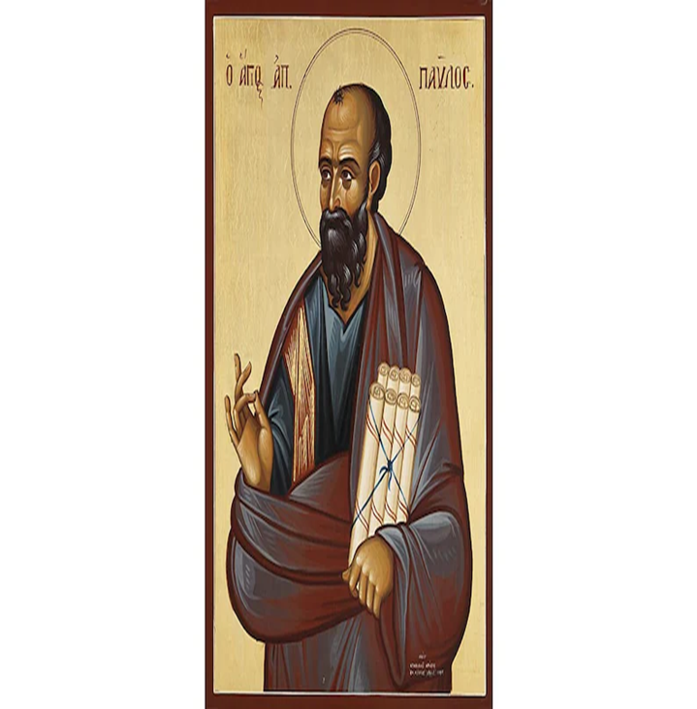
St Paul and Corinth:
He preached the city during his second missionary journey around 53 AD as in Acts chapter 18:1 and he stayed there for 18 months.
He visited the city again in 55 AD during his third missionary journey
Paul changed the life of the Corinthians from fornication and adultery to the life of holiness and purity.
Paul wrote the first Epistle to them in 57 AD from Ephesus
He wrote the second Epistle few months later from Macedonia.

Slide 4

1- The fragrance of Christ:

Slide 5

“For we are to God the fragrance of Christ among those who are being saved and among those who are perishing” 2:15
Aroma
Spread for distance
Not seen but you can smell
Expensive
Break the bottle to pour (at God feet)
Mark 14:3

Slide 6
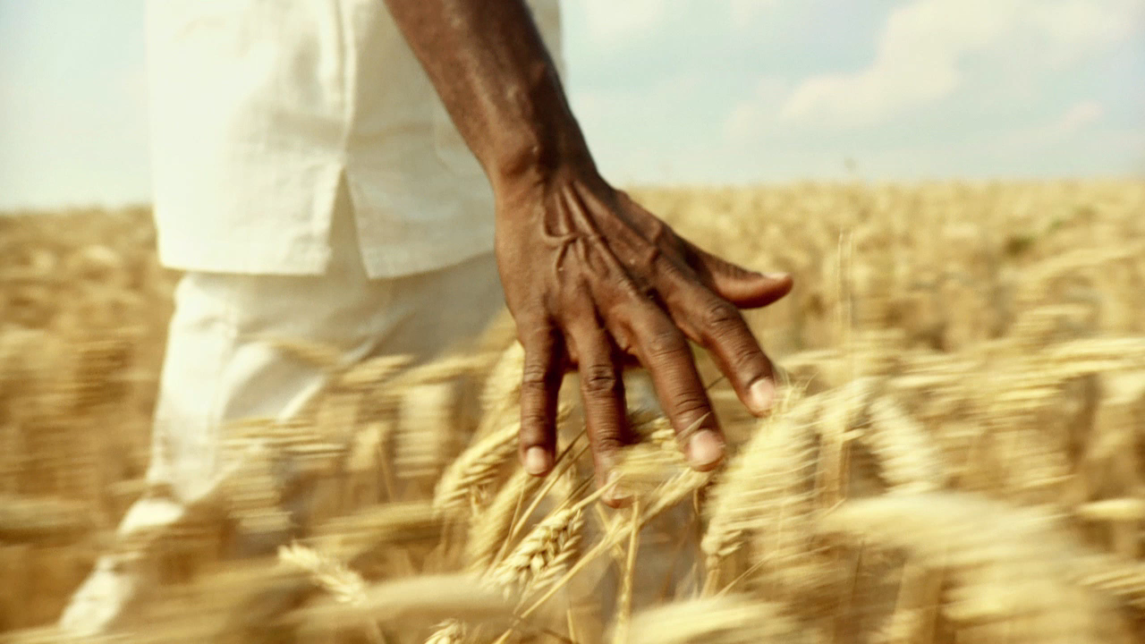
2- Ministers of the new covenant:

Slide 7
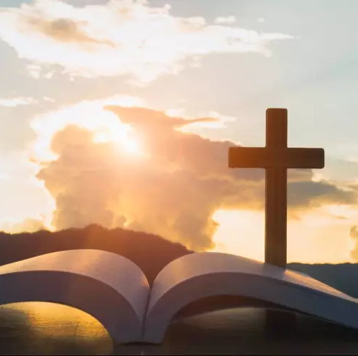
“ who also made us sufficient as ministers of the new covenant, not of the letter but of the Spirit; for the letter kills, but the Spirit gives life.” 3:6
God’s Love to every person
Our Love to God and others
Belief and Baptism
Communion
Resurrection
Eternal life

Slide 8
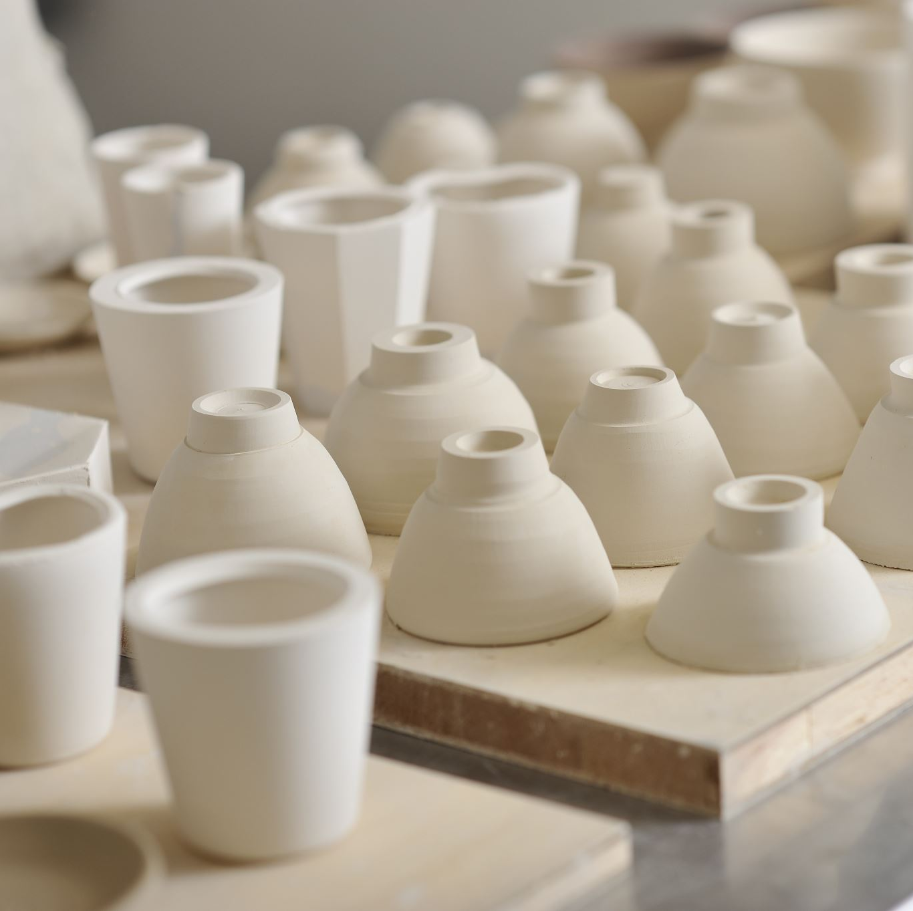
3- Earthen vessels

Slide 9
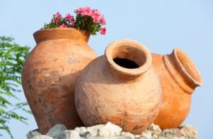
“But we have this treasure in earthen vessels, that the excellence of the power may be of God and not of us.” 4:7
Pottery vessels
The Apostles
St Paul (throne in the flesh) god told him “My grace is sufficient for you, for My strength is made perfect in weakness” 12:9
Church as lambs among wolves

Slide 10
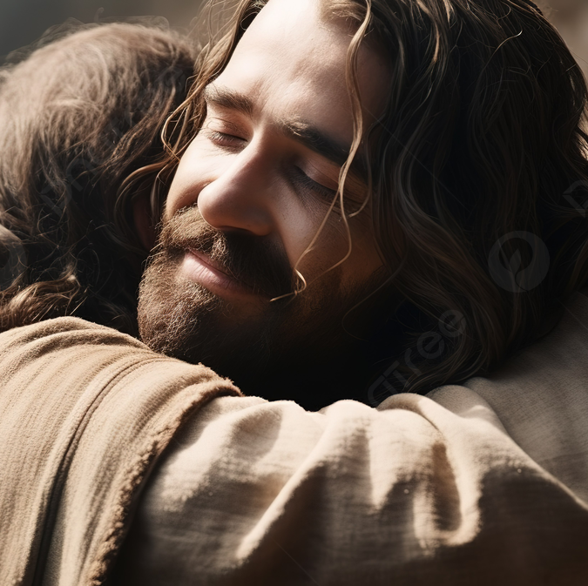
4- Ministry of reconciliation

Slide 11
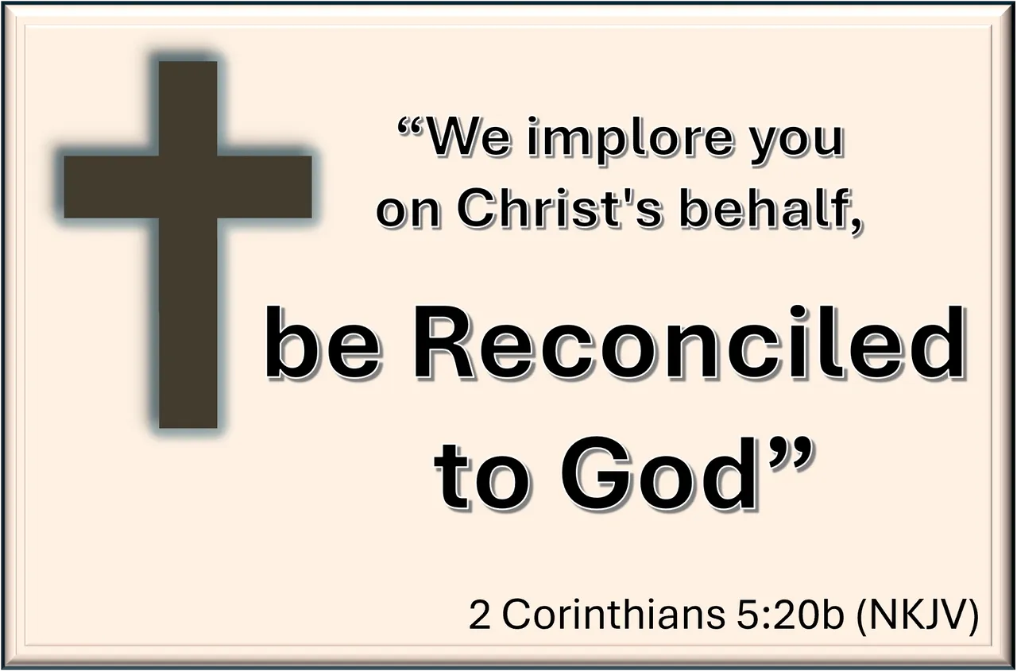
“Now all things are of God, who has reconciled us to Himself through Jesus Christ, and has given us the ministry of reconciliation” 5:18
Christ reconciled:
Man with God (Liturgy)
Man with himself
Man with others
Heavens with Earth
Servants do the same

Slide 12

5- Ambassadors for Christ

Slide 13

“Now then, we are ambassadors for Christ, as though God were pleading through us: we implore you on Christ’s behalf, be reconciled to God.” 5:20
God representatives
Church is part of heaven
In every country
“Go therefore and make disciples of all the nations” Matthew 28:19

Slide 14
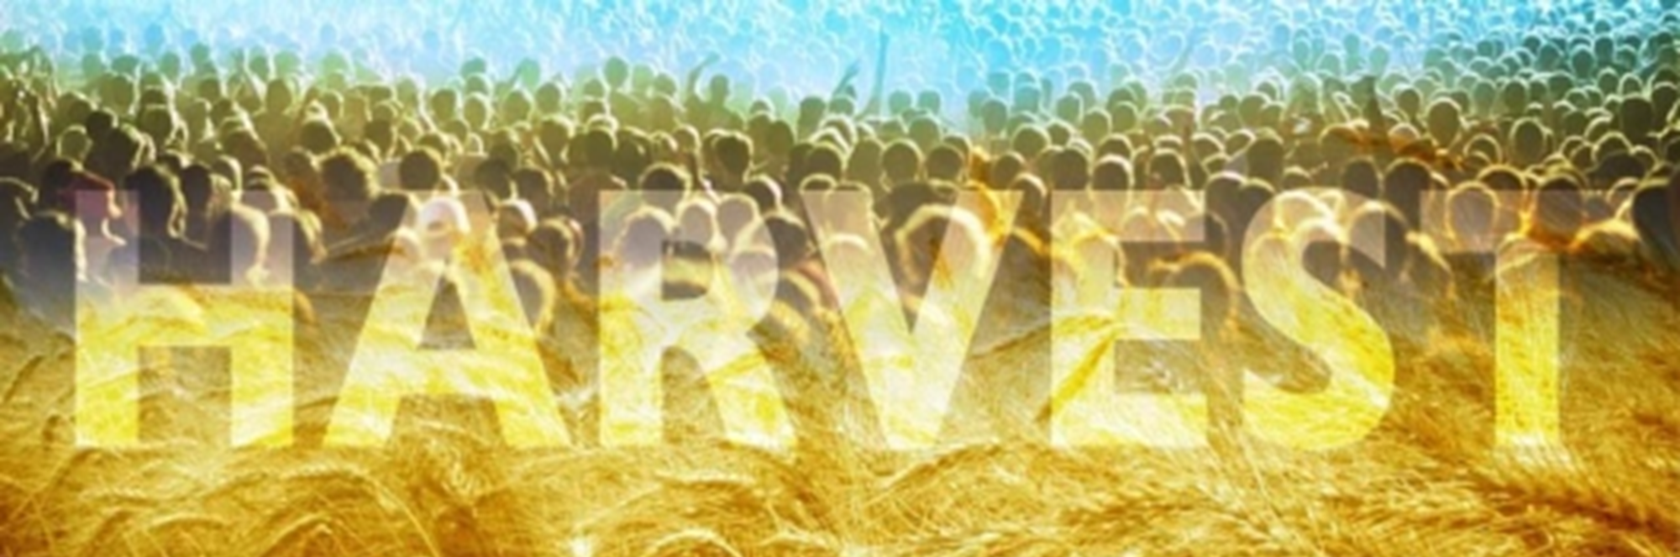
6- Workers together with Him (GOD)

Slide 15
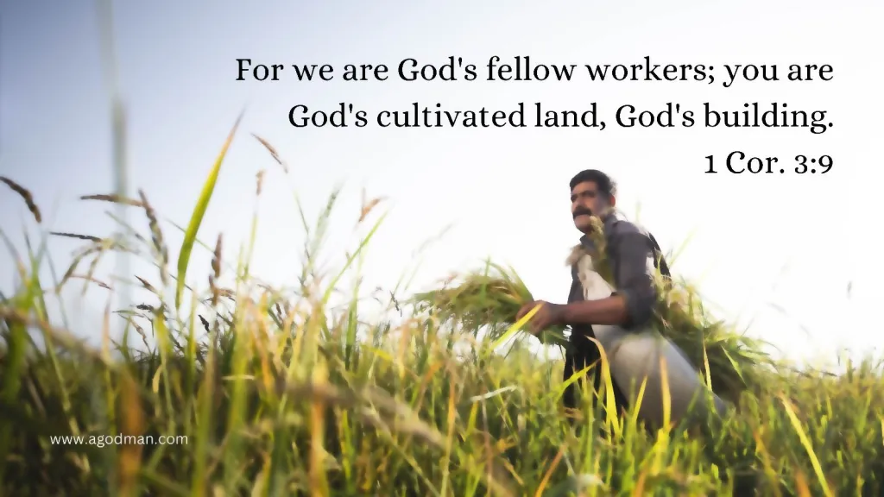
“We then, as workers together with Him also plead with you not to receive the grace of God in vain” 6:1
Teach
Preach
Reach out
Give your 2 cents

Slide 16
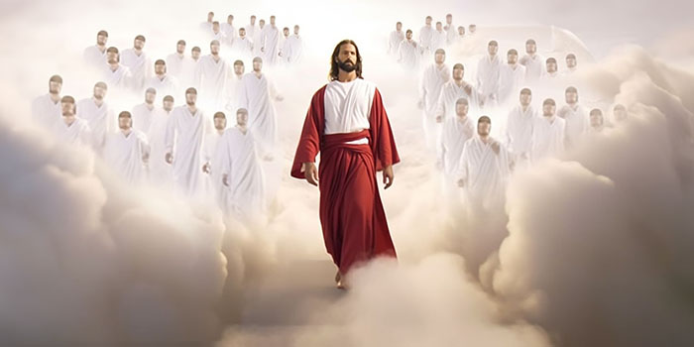
“They are messengers of the churches, the glory of Christ.” 8:23

Slide 17

You are:
1- The fragrance of Christ
2- Ministers of the new covenant
3- Earthen vessels
4- Ministers of reconciliation
5- Ambassadors for Christ
6- Workers with God
7- The Glory of Christ

Slide 18
Questions??

