Slide 1
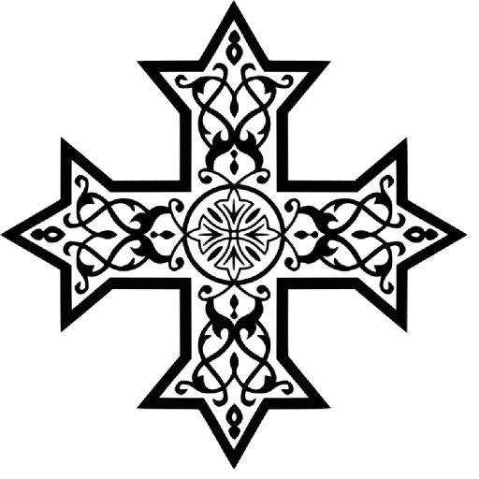
Christian Denominations
Comparative Theology
St. Mary and St. Philopater Coptic Orthodox Church
8th Grade Sunday School

Slide 2
CAUTION!
The purpose of this lesson is not to create divisions and hatred. God created and loves every single human being on earth. We must have that same love.
But, we must be able to discern correct and incorrect teachings.
We must also be able to respond to questions about why we may differ from other churches and to defend our faith.

Slide 3
What Churches are we (Oriental Orthodox - Non-Chalcedonian Churches) in communion with?
When did our Church(es) become separated from the other Churches?
Which Churches are Eastern Orthodox (Chalcedonian)?

Slide 4
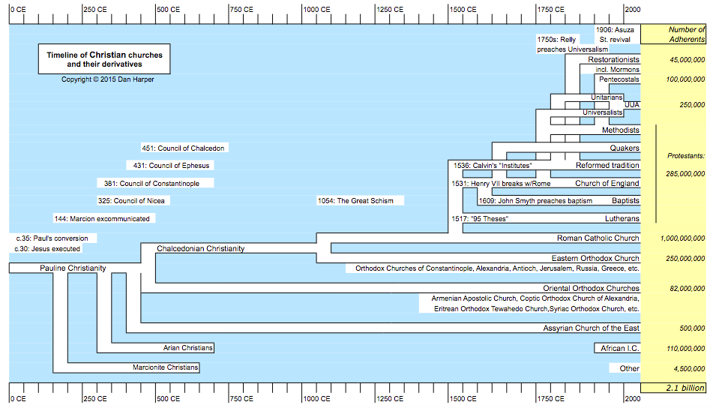

Slide 5
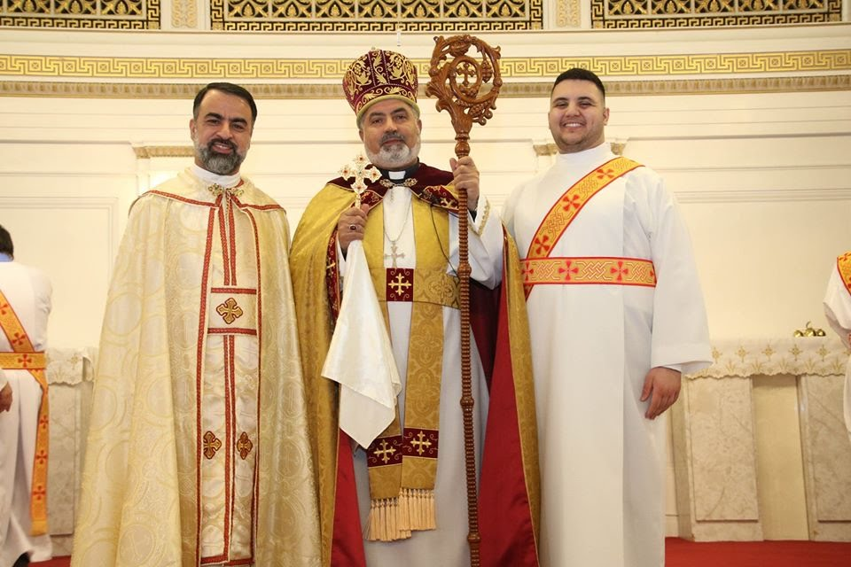
Assyrian Church of the East
ܥܕܬܐ ܕܡܕܢܚܐ ܕܐܬܘܖ̈ܝܐ
The continuation of the Church of the East, who split from the other churches at the Second Ecumenical Council of Ephesus in 431 AD.
  In 1552, the Church of the East split. One faction joined the Catholic Church, under the Chaldean Catholic Church, and the other faction remained as the Assyrian Church of the East.
They follow the heresy of Nestorianism
  A form of dyophytism – Emphasis on the two natures of Christ– human and divine– and the choice of the divine to take on, or to cloak itself with the human nature.
    Denies the hypostatic union.
  St. Mary is the Christokos (“Christ-bearer” of a the human, Christ), not Theotokos (“God-bearer”)

Slide 6
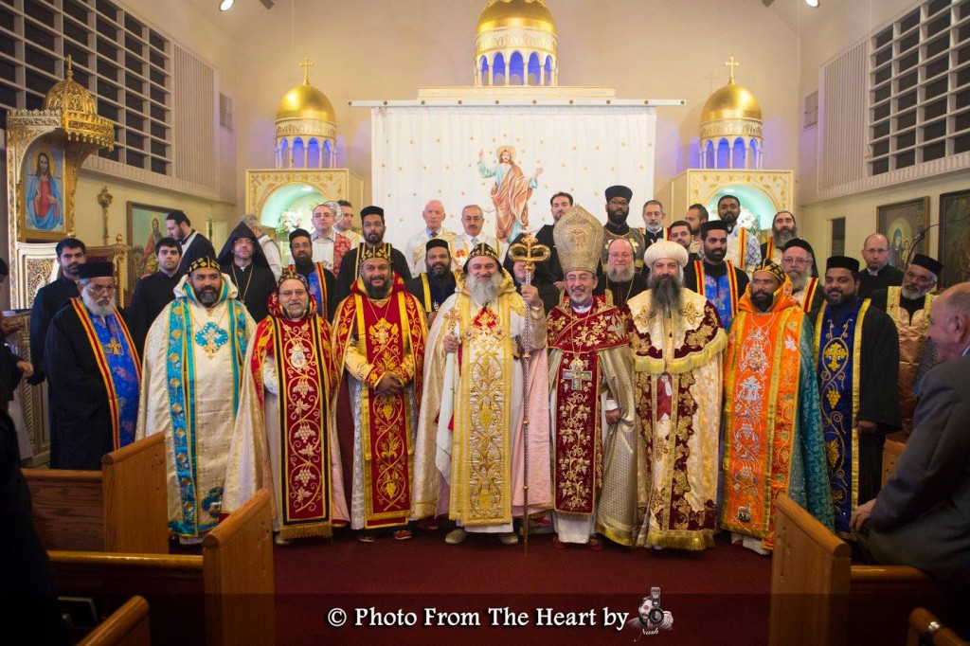
Oriental Orthodox Churches
Non-Chalcedonian / Miaphysite (one nature out of two)
Coptic Orthodox Church
Syriac Orthodox Church
Armenian Apostolic Church
Malankara Orthodox Syrian Church
  AKA Indian Orthodox Church
Ethiopian Orthodox Tewahedo Church
Eritrean Orthodox Tewahedo Church

Slide 7
What is the main difference between the Oriental Orthodox and Eastern Orthodox Churches?
When did the Eastern Orthodox and Roman Catholic Churches Split?

Slide 8
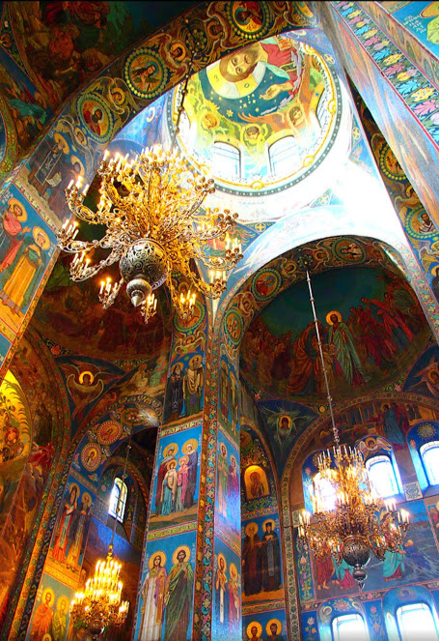
Eastern Orthodox Churches
Greek, Russian, Ukrainian, Polish, Serbian, Bulgarian, etc.
  Also, Orthodox Church of America
Only major difference in belief is the acceptance of the Ecumenical Council at Chalcedon in 451 AD
  Dyophytism – focusing on the two distinct natures of Christ.
  At the council, we were accused of being monophysite (one, single nature), rather than our actual belief as miaphysite.
Accept the first seven “ecumenical councils” – we accept only the first three.
There have been talks between our Churches to unite them
  We accept one another’s Baptism.

Slide 9
When did the Eastern Orthodox and Roman Catholic Churches Split?
What are the differences between the Oriental Orthodox Churches and the Roman Catholic Church?

Slide 10
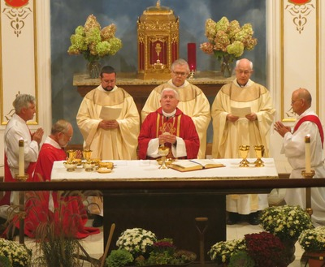
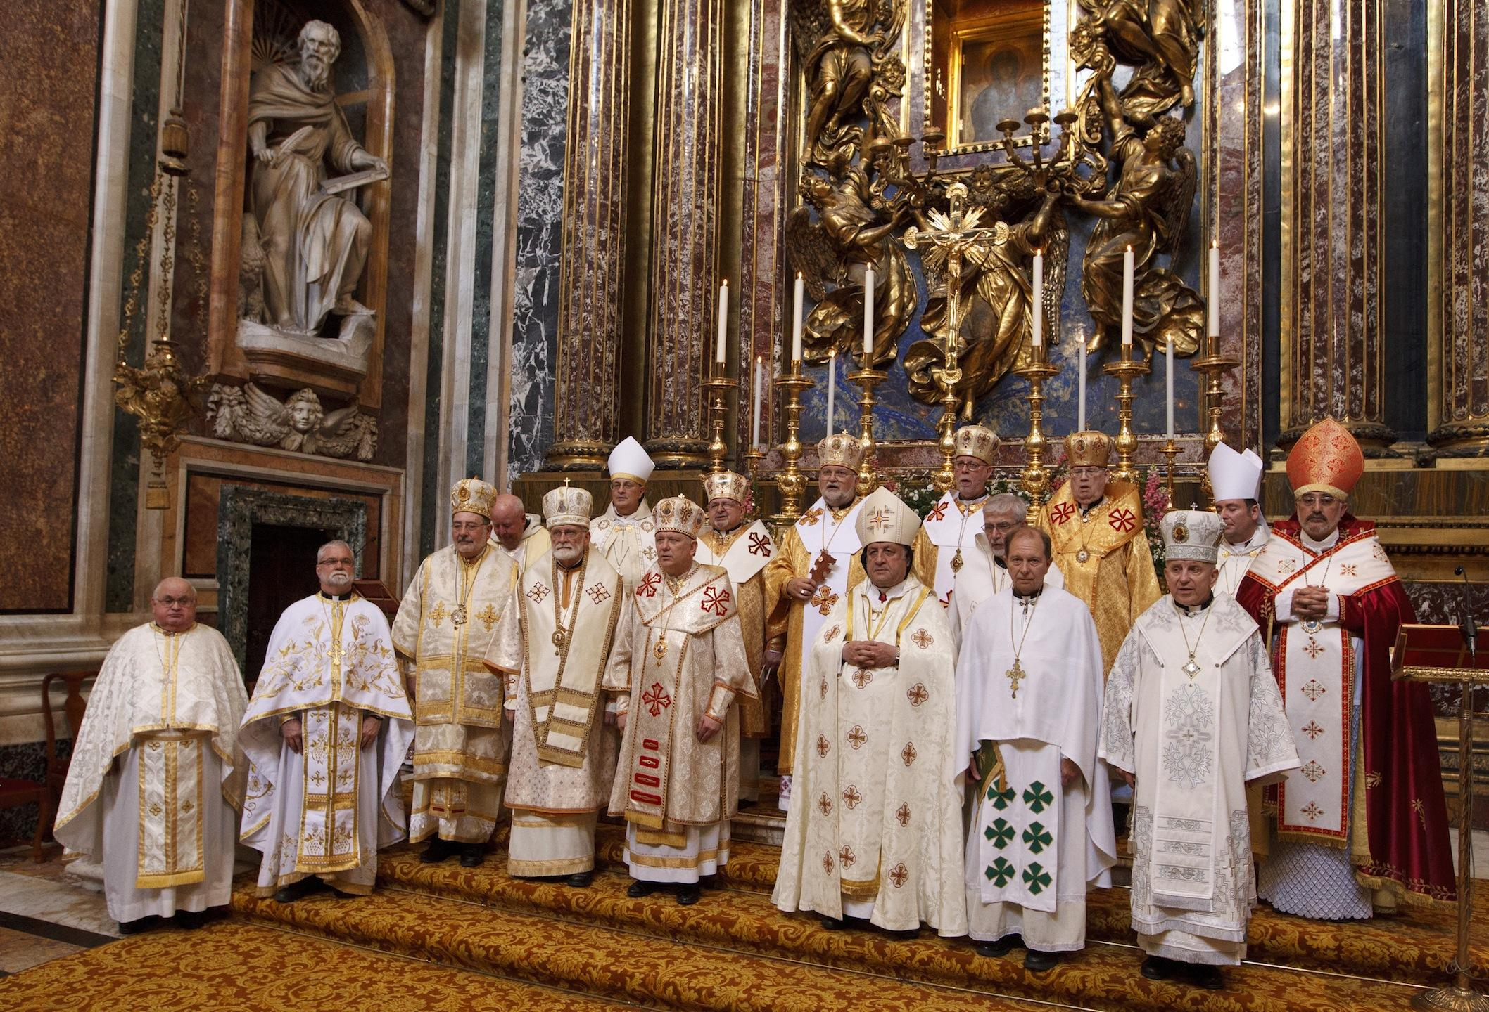
Roman Catholic Church Eastern and Latin Rite
“Great Schism” in 1054 split the Eastern Orthodox and Roman Catholic Churches
  A split of the Greek East from the Latin West – was preceded by widening differences between the traditions
    Major disputes were: Papal authority, use of unleavened bread, the Filioque, preference for celibate priests
  Some of the differences between us and the Roman Catholic Church are what lead to the Great Schism. Others arose after the split.
Differences of belief:
  Filioque (John 15:26)
  Immaculate Conception of St. Mary
  Papal Primacy / Supremacy
    St. Peter
    Infallible
  Venial and Mortal Sins
  Purgatory
  Celibacy of Priests
  Transubstantiation
  First Communion and Confirmation

Slide 11
Which churches are considered Protestant?

Slide 12
Protestant/Evangelical
Essentially any church who is outside of the Oriental, Eastern or Roman Catholic churches are Protestant/Evangelical
  Baptist, Calvinist, Lutheran, Methodist, Pentecostal, Evangelical, Anglican, Anabaptists (ex. Mennonites)
These churches were born during and after the Reformation in Europe
  A revolution against and challenging the Roman Catholic Church, particularly papal authority – which had given rise to abuse and corruption – and the sale of indulgences
1517 – brought frustrations to a head when Martin Luther (a Catholic monk, priest, and professor) published and began to distribute his Ninety-Five Theses (or Disputation on the Power and Efficacy of Indulgences).
  While he did not intend the Reformation, people began to listen to him, the “protest” against the Catholic church became widespread.
  In 1521, Luther was excommunicated and his followers were condemned

Slide 13
Foundation of Protestant Beliefs
The Five Solas (Latin word meaning “alone”) are believed to be the only doctrines necessary for salvation.
Christ Alone
  Christ is the only mediator – no veneration of saints, the Pope is not Christ’s representative head of the Church – all have direct access to God, all have equal potential to minister for God.
Scripture Alone
  Oral tradition and teachings of the Fathers are rejected as human tradition – so scripture is subject to private interpretation.
Faith Alone
  Faith in Christ alone is enough for eternal salvation (although good works attest to one’s faith in Christ and His teachings)
  “[F]aith without works is dead.” James 2:20. “You see then that a man is justified by works and not by faith only.” James 2:24
Grace Alone
  Salvation is a gift of God – an act of free grace – dispensed by the Holy Spirit owing to the redemptive work of Jesus Christ alone, not depending on good works.
Glory to God Alone
  Since salvation is accomplished solely through His will and action, no human being, saint, or clergy member is worthy of glory.

Slide 14
Examples of Protestant Churches
Lutheranism
  Retains liturgical practices
Church of England / Anglicanism
  After being refused an annulment from his marriage, King Henry VIII of England, separate the Church of England from Rome, in order to marry another woman.
  Later adopted Protestant Reformation beliefs
Baptist
  Earliest “Baptist” church began in 1609 – rejecting infant baptism and leaving only for older children and adults, as a ”believer’s Baptism.”
  Wide variety of beliefs
There is a wide variety of different beliefs among Protestant Churches, for example: the Eucharist is often thought of as a symbol, and Baptism is not necessary for salvation.
  An extreme view of this is that we literally sacrifice (kill) Christ each time we take Communion.

Slide 15
Do we consider Jehovah’s Witnesses to be Christian?
Do we consider Mormons to be Christians?

Slide 16
Jehovah’s Witnesses non-Christian cult
Jehovah’s Witnesses
  Do not believe in the Holy Trinity.
    Believe that God the father (Jehovah) is ”the one true and Almighty God” and that Jesus Christ is his firstborn son, not an Almighty God, but an inferior god. The Holy Spirit is not a distinct person, but God’s active force.
  Beliefs about Christ
    Before he became a man, he was the Archangel Michael, then became the physical Christ, and ceased to exist when he died (He was not bodily resurrected). He is now Archangel Michael again.
    Christ was crucified on a stake, not a cross (a pagan symbol)
  There is no immortal soul – only the “elect” 144,000 will have immortality in heaven with Jehovah – everyone else will cease to exist
  Have hierarchy Witnesses who form a Governing Body, who Christ uses as a channel for God’s revelations
  Have previously predicted the end of the world, or Armageddon, which failed to happen at the predicted time
  Teachings are published in the Watchtower publication
  Refuse to celebrate birthdays or holidays (as are not Biblical) and refuse to give or accept blood transfusions

Slide 17
Mormons or Church of Latter Day Saints non-Christian cult
Four groups of people settled on the American continent by 600 B.C.
  Jaredites (after the Tower of Babel)
  Nephites (righteous followers of the son of Lehi (an Israelite from Jerusalem), Nephi
  Lamanites (wicked follower of the other son of Lehi, Laman
    The Lamanites are considered the ancestors of Native Americans
  Mulekites (a son of King Zedekiah, settled with his own group)
Through wars and other events, only two main groups, the Nephites and Lamanites
33 A.D. - after His death and resurrection, Jesus Christ appeared and preached to the Nephites, resulting in a peaceful united nation for 200 years, until war again occurred.
Eventually the Nephites were destroyed by the Lamanites, but a Nephite prophet named Mormon, was collecting and writing the record of the Nephites onto gold plates. Eventually, Mormon was killed, leaving his son, Moroni, as the only surviving Nephite.
Moroni completed the records, and buried them in 421 A.D., before he died.

Slide 18
Mormons or Church of Latter Day Saints non-Christian cult
Book of Mormon
  Believe that Joseph Smith Jr. had visions where the angel Moroni informed him of a book written on gold plates by former inhabitants of the North American continent that contained the “fullness of the everlasting gospel.”
  At the age of 21, he found the plates and began translating them using “seer” stones. – after which, Moroni came back and retrieved the gold plates
    The plates were engraved in an unknown language called “reformed Egyptian”
Book of Abraham
  Forms part of the Mormon collection of works, “Pearl of Great Price”
  Joseph Smith purchased two Egyptian scrolls from a traveling mummy exhibition in about 1835 and translated them, showing that they were the writings of Abraham in Egypt.

Slide 19
Mormons or Church of Latter Day Saints non-Christian cult
Source of teachings are the Holy Bible, the Book of Mormon, Doctrines and covenants, and the Pearl of Great Price as revealed to Joseph Smith, Jr.
Endowment Ceremony
Polygamy
  Joseph Smith Jr.
  Jesus
Black People and Priesthood
Lamanites
Baptism of the Dead
The god of our planet was once a man on another planet, but through his self-effort and the help of his own father-god, was appointed by a counsel of gods in the heavens to his high position as the god of planet Earth. He has a wife named the Heavenly Mother.
  Our earth was created by the pre-mortal Jesus, and the Archangel Michael, the pre-mortal Adam.
  The Garden of Eden was in North America and the New Jerusalem will be built on the American continent.
Essentially, if we live, by the atonement of Christ and with good deeds, we will make it to one of the three tiers in heaven. The highest being a god or goddess of your own planet, with your family.

