Slide 1

Spiritual Service
Vs
Social Service

Slide 2
Agenda:
Goals
Shape
Interest
Results

Slide 3
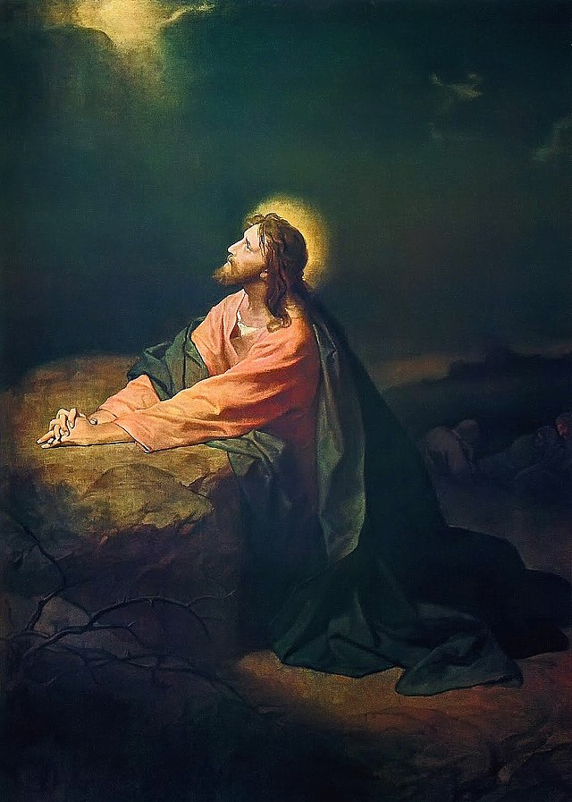
⁴ I have glorified You on the earth. I have finished the work which You have given Me to do. ⁵ And now, O Father, glorify Me together with Yourself, with the glory which I had with You before the world was.⁶ “I have manifested Your name to the men whom You have given Me out of the world. They were Yours, You gave them to Me, and they have kept Your word. ⁷ Now they have known that all things which You have given Me are from You. ⁸ For I have given to them the words which You have given Me; and they have received them, and have known surely that I came forth from You; and they have believed that You sent Me.
John 17: 4-8

Slide 4
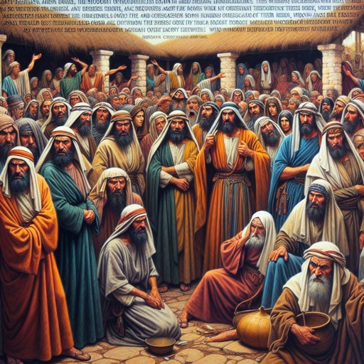
“Now in those days, when the number of the disciples was multiplying, there arose a complaint against the Hebrews by the Hellenists, because their widows were neglected in the daily distribution. 2 Then the twelve summoned the multitude of the disciples and said, “It is not desirable that we should leave the word of God and serve tables. 3 Therefore, brethren, seek out from among you seven men of good reputation, full of the Holy Spirit and wisdom, whom we may appoint over this business; 4 but we will give ourselves continually to prayer and to the ministry of the word.” Acts: 1-4

Slide 5
1- Goals:
Spiritual
The Spread of heavenly kingdom: as we pray daily “your kingdom come” i.e. God becomes our king.
Salvation: “who desires all men to be saved and to come to the knowledge of the truth.” 1 Timothy 2:4, Also in Agpeya prayers book, we conclude each hour with “who calls all to salvation”. This will be done via repentance.
Glory of God and his sons (through our deeds).
The servant personal salvation “But I discipline my body and bring it into subjection, lest, when I have preached to others, I myself should become disqualified.” 1 Corinthians 9:27”

Slide 6
Social:
Moral aspects, no repentance, salvation or heavenly kingdom.
Christ is not in this service, but improvement of social status only.
Good but not enough.
Some churches interested in it more than God Glory.
Sometimes we do the same in Sunday School, we should be careful. e.g. Saint Party, summer camp trips ……

Slide 7
2- Shape:
Spiritual:
Service is led by Christ, guided by the bible. We all different organs in Christ body.
“in honor giving preference to one another” Roman 2:10
“He must increase, but I must decrease” John 3:30
“So then neither he who plants is anything, nor he who waters, but God who gives the increase.” 1 Corinthians 3:7
We may be different in talents, knowledge, backgrounds but under Christ leadership, our eyes toward him and heaven like Israelites in the wilderness and the Tabernacle in the midlist.
Anybody who deviate from this path will tear up and divide the church.

Slide 8
Social:
Everyone leads based on his own thoughts, skills, experience and vision.
Depend on Morals not spiritual bases (note that morals will be secondary to spirituality not the opposite)
Sometimes lead to division between servants, competition, and different leaders lead in different direction.
No known references to follow.
Not looking to Eternal life.

Slide 9
3- Interest:
Spiritual:
Repentance, enjoy the church rites, history and life.
The kids’ spiritual growth (praying, confession and communion).
Bible study, praying, understand church history and dogma.
Deliver our experiences to the kids like, how to fast and pray, celebrate saints' feasts, know their lives and glorifications.
Attending church spiritual nights, conventions and visiting monasteries

Slide 10
Social:
Service may mimic in shape the spiritual activities but has no goal
Activities just for activities.
Do not pay attention to spiritual growth or eternal life.
The service does not care about every person individually.

Slide 11
4- Results:
Spiritual:
Repentant souls, rejoicing with God.
The Servant changes and the kids change too. Even slowly.
Bishop Benjamin started his service in churches where no body was attending but ended in churches full of Christians.
Bishop Basilios started his service with only 17 families in his diocese, but his service ended with only 17 Pagan families in the Diocese.
Hearts are filled with God’s love.

Slide 12
Social:
As done by different motives of different groups, based on hobbies or similarities, Christ is missed.
Kids may not continue in the church as they did not have personal relationship with God, did not taste Christ.
Isolated islands in the church.

Slide 13


