Slide 1
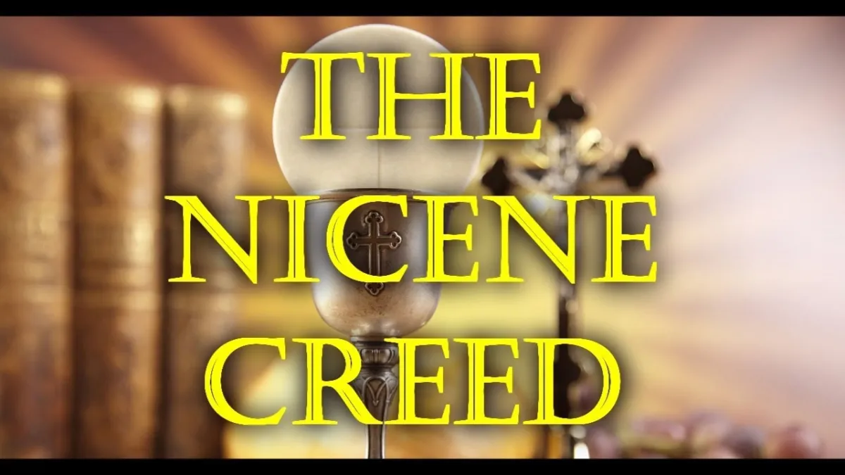

Slide 2
In the Orthodox Church, the creed is usually called The Symbol of Faith which means literally the “bringing together” and the “expression” or “confession” of the faith.
The word creed comes from the Latin (credo) which means “I believe.”
One Creed has been formulated by Ecumenical Council of Nicaea in the year 325 A.D.
The Creed was validated by an ecumenical council formed of representatives of all the churches in the world.
The Coptic church was represented in this council by Pope Alexander, the nineteenth patriarch of Alexandria, accompanied by his deacon Athanasius who formulated all the items of the Creed.
The part on the Divinity of the Holy Spirit has been added in the Ecumenical Council of Constantinople held in 381 A.D. to refute Macdonius' heresy which denied the Divinity of the Holy Spirit.
Any denomination that does not believe in the Creed as a whole, cannot be considered Christian

Slide 3
The Creed includes the following main facts of the faith:
1. The Unity of God. The Creed starts with the words "Truly we believe in One God".
2. The Holy Trinity.
3. The Incarnation, Redemption, and Salvation.
4. Baptism for the Remission of Sins.
5. The Resurrection of the Dead and the Life to Come in Eternity
6. The Second Coming of Christ for judgment.
7. The One Holy Catholic Apostolic Church.

Slide 4
We believe in one God,
God the Father the Pantocrator who created heaven and earth, and all things seen and unseen.
We believe in one Lord Jesus Christ, the Only-Begotten Son of God, begotten of the Father before all ages; Light of Light, true God of true God, begotten not created, of one essence with the Father, by whom all things were made; Who for us men and for our salvation came down from heaven, and was incarnate of the Holy spirit and the Virgin Mary and became Man. And He was crucified for us under Pontius Pilate, suffered and was buried. And on the third day He rose from the dead, according to the scriptures, ascended to the heavens; He sits at the right hand of his Father, and He is coming again in His glory to judge the living and the dead, Whose kingdom shall have no end.
Yes, we believe in the Holy Spirit, the Lord, the Life-Giver, Who proceeds from the Father, Who with the Father and the Son is worshipped and glorified, who spoke by the prophets.
And in one holy, catholic and apostolic church.
We confess one baptism for the remission of sins.
We look for the resurrection of the dead, and the life of the coming age. Amen

Slide 5
We believe:
Faith includes belief, trust, conviction and complete acceptance with the mind and heart.
Faith does not contradict with the intellect but is above its level.
The mind accepts what faith presents to us.
Truly we believe: It is not mere faith we inherited from our fathers or mothers who were believers, but we truly believe, with conviction in our hearts, with all truth.
In One God:
Believing in One God is the first of the Ten Commandments. The Lord says, “I am the Lord your God. You shall have no other gods before Me" (Ex.20: 2,3) (Deut 5: 6,7).
And St. James the apostle says, "You believe that there is one God, You do well. Even the demons believe and tremble!“ (James 2:19).

Slide 6
God The Father:
The Creed speaks about each Person (hypostasis) of the Holy Trinity separately, starting with the Father.
God the Father is the Father in the Holy Trinity (The origin)
"No one has seen God at anytime. The only begotten Son, who is in the bosom of the Father, He has declared Him“
The Pantocrator (The Almighty):
He governs all the creation, nothing is out of His control
God, out of His extreme mercy and compassion, granted us a free will.
There is a difference between God’s intent and God's permission.
God's intent is ultimately good; however, He gives rational creatures power to act within limits.
God may also interfere and stop the work of the wicked.
God controls everything, not only the acts, but also the thoughts and intents.

Slide 7
who created:
The word "Creator" is an attribute of God alone. He creates from the nonexistent.
Human mind can be a maker not a creator.
Man made everything with the mind which God created in him.
The Father created everything through the Son
heaven and earth:
The first verse of the Holy Bible says, "In the beginning God created the heavens and the earth“(Gen 1:1)
St. Paul the Apostle tells us that he was caught up to the third heaven (the Paradise). The first heaven is the atmosphere surrounding the earth, which we calI, the heaven of the birds. The second heaven is the solar system.
Above these three heavens is the "heaven of heavens"

Slide 8
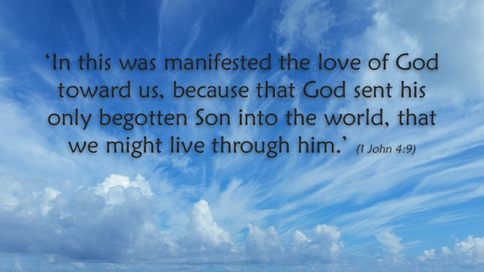
and all things seen and unseen:
Everything we can see by our own eyes, or we can't see.
The spirits for example are among the invisible things.
Very minute (bacteria and viruses) or very far things
Hidden elements (underground metals, oil and natural gas)
Mind (not brain)
Wisdom or faith

Slide 9
We believe in One Lord:
The word "Lord" means also "master" and "God", and when we say “O Lord" in our prayer, we mean “O God“
Christ is called also "Lord of the Sabbath" (Mt. 12: 8)
Christ is not only entitled "Lord" but also the Lord of Lords (Rev. 19:16).
Jesus Christ:
The word "Jesus" means "savior“
"you shall call His name Jesus, for He will save His people from their sins" (Mt. 1: 21).
The word "Christ", literally means anointed, it refers to His mission as King, Priest, and Prophet.
Our Lord Jesus Christ, He is not just an anointed one like the others but Christ or ''Messiah'' as they used to call Him.
Humanity and Divinity

Slide 10
The Only- begotten Son of God:
He is alone the Son of God of His same nature, essence and divinity.
No one has seen God at any time. The only begotten Son, who is in the bosom of the Father, He has declared Him.(John. 1:18). Also 3:16 and 3:18
Begotten of the Father before all ages:
This is regarding His Divinity
All things were made through Him, and without Him nothing was made that was made" (Jn. 1:3).
Light of light:
He is Light in the theological sense not the material sense.
“I am the light of the world” (Jn 8:12)
His nature, is unapproachable Light, but when He became flesh and dwelt among us, we became able to approach Him.

Slide 11
True God of True God:
"True God" means that He truly has the nature of God not like the so called gods or lords
Moses was called God to Pharaoh
The word "gods" was also used to refer to the gods of nations and to many humans called children of God.
The Lord Christ, He is true God, having all the attributes of divinity.
He is Everlasting, Creator, Almighty etc.
Begotten not created:
He is born of the Father, but not made. as He is born since eternity "having neither beginning of days nor end of life"(Heb.7: 3).
As the thoughts are begotten of the mind and as the rays from the sun.
of one essence with the Father:
See above

Slide 12
by whom all things were made:
See above
Who for us men and for our salvation:
Incarnate because he loved us and came for our salvation and redemption.
He restored the ideal image of man in which He was created.
came down from heaven:
It means that Heaven is His home.
“I came forth from the Father and have come into the world. Again, I leave the world and go to the Father.” (Jn 16:28)
Dwelling first in heaven is a proof of His divinity
He descended from heaven to earth but continued in heaven because He is present everywhere and no place is empty of Him.
“No one has ascended to heaven but He who came down from heaven, that is, the Son of Man who is in heaven” (John 3:13)

Slide 13
and was incarnate:
The word "incarnated" means He took flesh.
It means that the divine nature united with the flesh.
of the Holy spirit and the Virgin Mary and became Man:
How incarnation was completed.
He became a complete man with a human nature.
He was crucified for us under Pontius Pilate:
Means on our behalf or instead of us.
Christ is the Holy who can die for the others.
He was not a sinner but bearer of sins.
He replaced us in the crucifixion, the death, the shame, and the curse.
Pontius Pilate??? Historical confirmation
Suffered and was buried:
True suffering and death

Slide 14
And on the third day He rose from the dead, according to the scriptures:
The Lord Christ arose by Himself not raised by anyone.
He alone arose in a glorious body.
Christ is the only One who arose and did not die again.
The resurrection of Christ is a proof of His power and His victory.
ascended to the heavens, He sits at the right hand of his Father:
of course He ascended in the body (flesh).
The words "ascended to heavens" means ascended to the heaven of heavens.
ln the Biblical Terminology the right hand refers to power, righteousness, or honor or glory.

Slide 15
and He is coming again in His glory to judge the living and the dead:
The glory of His divine nature
As He said, “He comes in His own glory, and in His Father’s, and of the holy angels.” (Luke 9:26) and (Mathew 16:27)
His Second coming will be for judgment.
His second coming will be in the end of ages
The general resurrection will take place
Whose kingdom shall have no end:
His kingdom is a spiritual kingdom not an earthly one.
“and of His kingdom there will be no end” (Lk. 1:33).

Slide 16
Yes, we believe in the Holy Spirit, the Lord, :
We believe that God is alive; by His Spirit, and the Holy Spirit is the Spirit of God the Father and the Spirit of the Son.
“for it is not you who speak, but the Spirit of your Father who speaks in you.” (Mathew 10:20)
“God has sent forth the Spirit of His Son into your hearts” (Galatians 4:6)
the Life-Giver:
It is well known that the Spirit is the source of life, thus He is the Life-giving
“It is the Spirit who gives life” John 6:63
Who proceeds from the Father:
This is said by the Lord Jesus Christ when speaking about the Holy Spirit “the Spirit of truth who proceeds from the Father"(Jn. 15: 26).
Who with the Father and the Son is worshipped and glorified:
Result of the above section

Slide 17
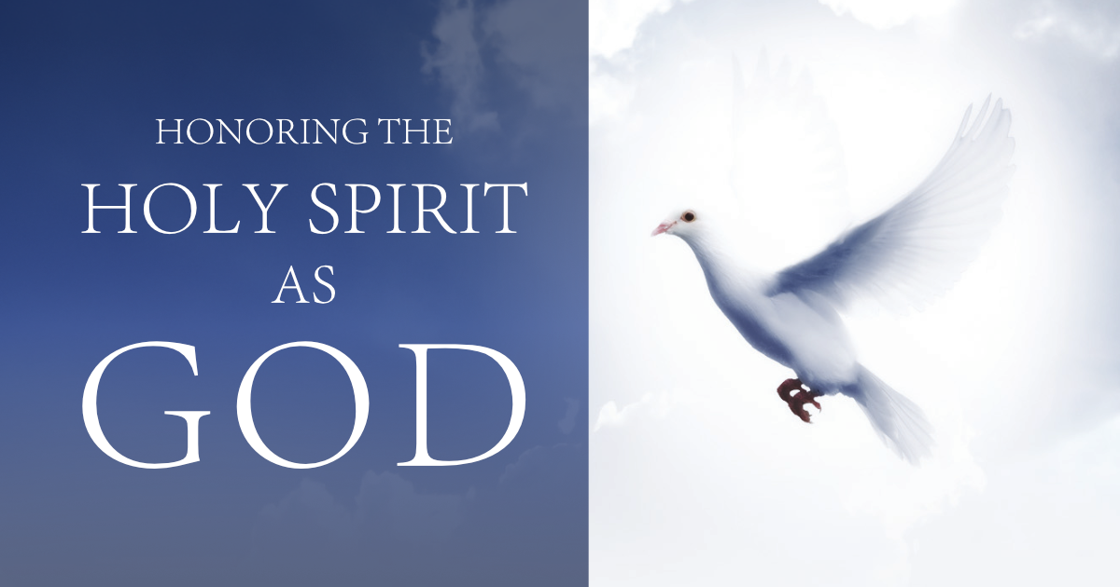
who spoke by the prophets:
This is clear in the words of St. Peter the apostle: " for prophecy never came by the will of man, but holy men of god spoke as they were moved by the Holy Spirit“ (2 Pet. 1: 21).
The Lord Christ said to His disciples, "it is not you who speak, but the Holy Spirit" (Mark 13: 11).
St. Paul the apostle said, "These things we also speak, not in words which
man's wisdom teaches but which the Holy Spirit teaches ... " (1Cor. 2: 13).
The words "Who spoke in the prophets" refer to the divine inspiration.

Slide 18
And in one holy, catholic and apostolic church:
The word "Church" signifies three things:
a) The church building.
b) The congregation.
c) The church leaders or priests.
She is One in faith, in dogma, in thought and doctrine, and in spirituality.
She is One church as she is One Body and the. Head of this body is the Lord Christ.
The church is One as she is Christ's bride.
She is One Church, on earth, and in heaven.
Holy:
She is holy by the blood of Christ.
The Church is holy in the baptism.
The church is holy in the Sacrament of the Holy Anointment.
The Church is holy because she is in God's image regarding holiness.

Slide 19
Catholic (universal):
The church is universal, gathering all believers together in the unity of faith.
This universal church brought together ,the Jews and the gentiles, as well as all nationalities, peoples, and tongues in one faith.
Nowadays, due to differences in faith among churches, it has become difficult to hold an ecumenical council for the Universal Church.
apostolic church:
The term "apostolic" signifies two meanings:
    a church founded by the apostles, and
    she follows the teachings of the apostles, not opposing these teachings. "having been built on the foundation of the apostles and prophets, Jesus Christ Himself being the chief cornerstone" (Eph. 2: 20).

Slide 20
We confess one baptism for the remission of sins:
Baptism is the first Church Sacrament, by which a believer becomes a member of the church.
As St. Peter said, "Repent and let every one of you be baptized in the name of Jesus Christ for the remission of sins" (Acts 2: 37, 38).
" Most assuredly, I say to you, unless one is born of water and the Spirit, he cannot enter the kingdom of God“ (John 3: 5).
It is one baptism, but should:
  One sound faith
  Be perfected by a recognized priest
  Be perfected in a sound way
  Not repeated

Slide 21
We look for the resurrection of the dead:
We believe in the resurrection of all the dead: righteous and sinners.
We shall rise in spiritual heavenly bodies.
“For the Son of Man will come in the glory of His Father with His angels, and then He will reward each according to his works. “ Mathew 16:27
So, three serious events will take place successively, namely:
1. The Second Coming of our Lord Jesus Christ.
2. The resurrection of the dead
3. The general Judgment
and the life of the coming age. Amen:
Will begin in the heavenly Jerusalem where God will dwell with men
The righteous who wait in Paradise will move to that City.
There shall be no more death , nor sorrow, nor crying, nor pain ,for the former things have passed away, and He who sits on the throne says, .. Behold, I make all things new“ (Rev. 21: 4, 5).

Slide 22
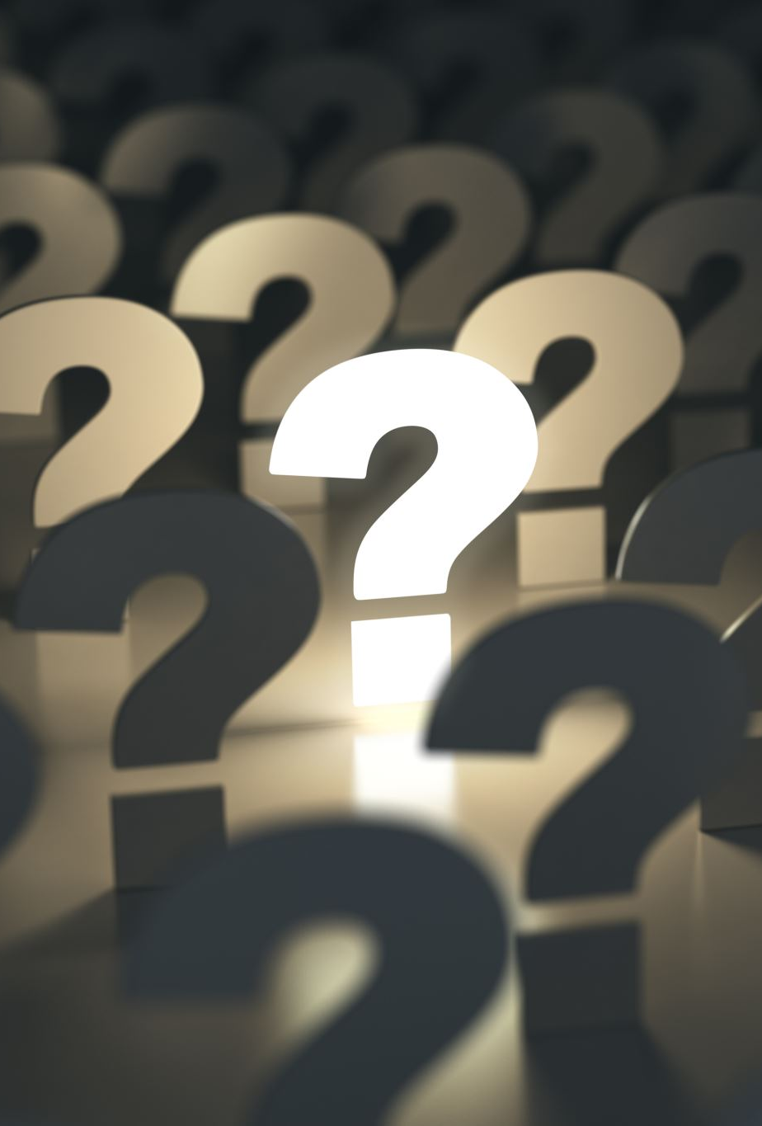
Questions??

